Slide 1

Autumn Term Enrichment Clubs
Name:____________________________________
Tutor Group:_______________________________
Enrichment Clubs I am going to attend
Monday
Tuesday
Wednesday
Thursday
Friday

Slide 2

Character Virtues and Employability Skills Links
Each Enrichment club is designed to link to one or more of our school Character Virtues and Employability Skills so that you can record this activity in your Unifrog account to record the skills you are developing to use to talk about in College, Apprenticeship and job interviews. Look out for the icons next to each club.

Slide 3
Enrichment Categories on offer - attend a club from each category throughout the year to earn your Enrichment Award!
Civic Engagement
Make a positive difference in your school and wider community. Through activities such as volunteering, debating, student leadership, fundraising, mentoring and community projects, pupils develop confidence, communication skills and a sense of social responsibility. These experiences encourage young people to become active, informed citizens who can contribute meaningfully to society.
Arts and Culture
Explore creativity, self-expression and cultural understanding through a wide range of artistic experiences. Whether participating in music, drama, dance, visual arts, creative writing or attending live performances, museums and galleries, pupils develop their imagination, appreciation of culture and confidence in expressing their ideas and talents.
Nature, Outdoors and Adventure
Discover the benefits of learning beyond the classroom through outdoor experiences and environmental projects. Activities may include gardening, sustainability initiatives, conservation work, outdoor learning, residential trips and adventurous challenges. Pupils develop resilience, teamwork, independence and a deeper understanding of the natural world.
Sport and Physical Activities
Promote physical wellbeing, teamwork and personal achievement through a variety of sporting and fitness opportunities. From competitive team sports and individual activities to dance, cycling and fitness clubs, pupils can develop their skills, improve their health and represent the school while building confidence, determination and resilience.
Developing Wider Life and Future Skills
Prepare for future success by developing practical skills, knowledge and experiences that support lifelong learning and employability. Activities may include STEM projects, coding, enterprise, financial education, cooking, public speaking and leadership opportunities. Pupils gain confidence, problem-solving abilities and the essential skills needed for further education, employment and everyday life.

Slide 4
CIVIC ENGAGEMENT CLUBS
Other events and activities that will support your involvement in this category are;
Pupil Voice
Prefects and House Captains
Peer Mentoring
Year Group Charity Selection
Community Volunteering
Youth Parliament
Intergenerational Projects with Care Homes
Fundraising Events
Nurse’s Day Hamper
Xmas Hampers
Visit to the UK Parliament, Westminster
Local Council Chambers Visit
Magistrates' Court Visit
Community Litter Pick Projects
Remembrance Day Events
Charity Fun Runs and Sponsored Challenges
Local Food Bank Volunteering
National Citizen Service (NCS)
Mock Elections
Christmas Market and Summer Fair
Transition Day

Slide 5
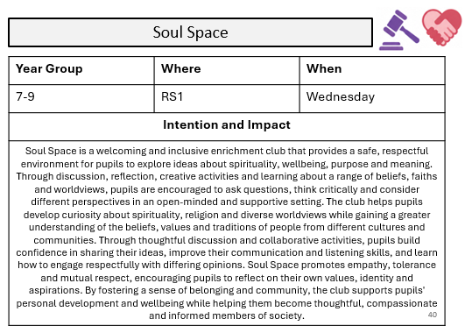
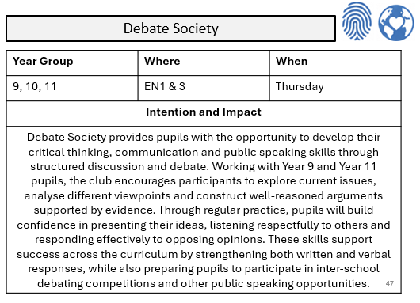

Slide 6
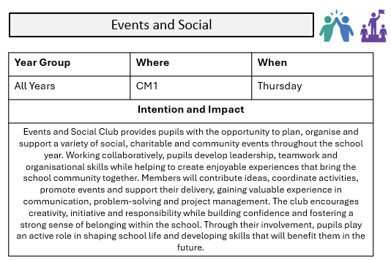
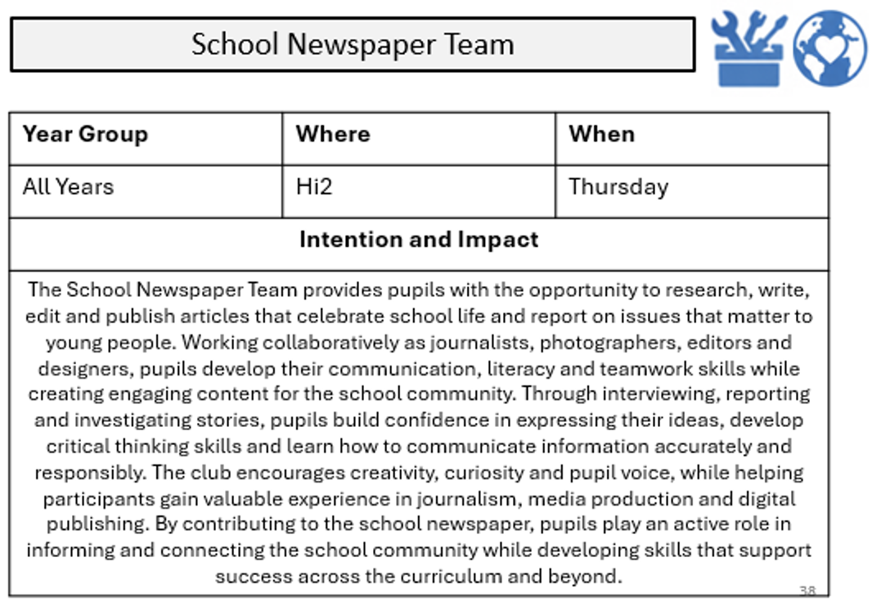

Slide 7
ARTS AND CULTURE CLUBS
Other events and activities that will support your involvement in this category are;
Cultural Celebration Events
School Diversity Week
Languages Week
Pride Month
West End Theatre Trips
Visit to the British Museum
Visit to the National Gallery
Visit to the Victoria and Albert Museum
Dance Workshops with Professional Companies
Music Concerts
Shakespeare Workshops
Art Gallery Visits
Local Arts Festivals
Cultural Heritage Days
School Performing Arts Shows
Arts Awards Programme
Dance Live
Move It
Musical Con Trip
Rome Residential Trip
Madrid Residential Trip

Slide 8
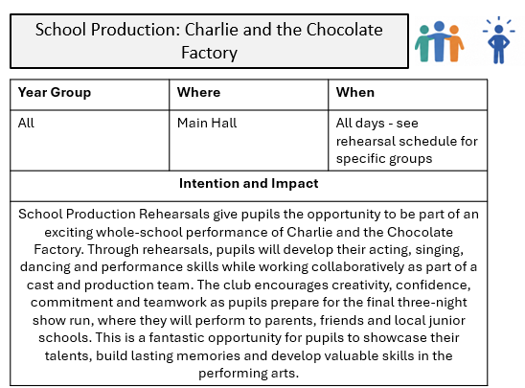
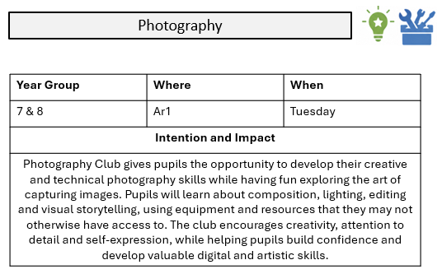

Slide 9
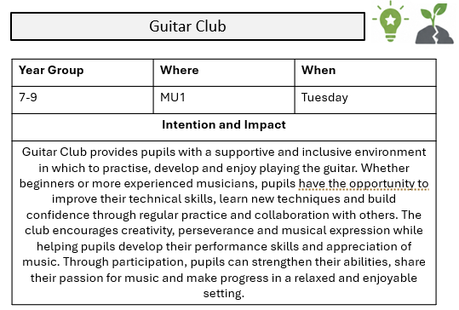


Slide 10



Slide 11
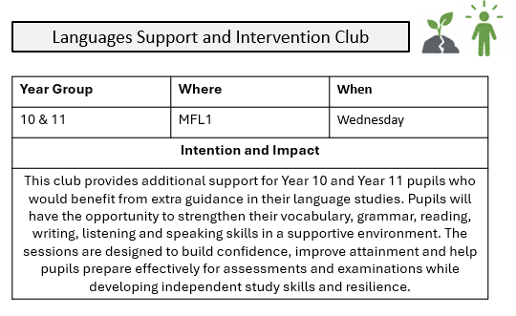
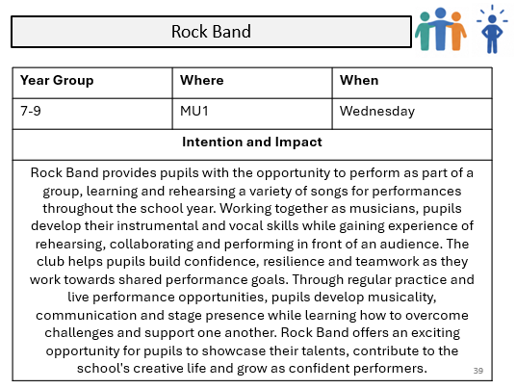

Slide 12

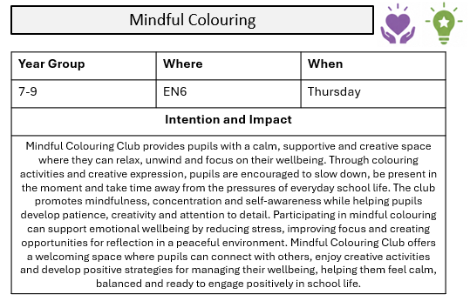

Slide 13

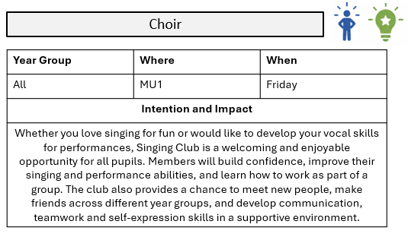

Slide 14
NATURE, OUTDOORS AND
ADVENTURE CLUBS
Other events and activities that will support your involvement in this category are;
Wildlife Conservation Projects
Sustainability Ambassadors
Outdoor Learning Sessions
Orienteering
Beach Clean Projects
School Allotment
Residential Adventure Trips
Outdoor Activity Centres
South Downs National Park Walks
Camping Expeditions
Geography Field Trips
Environmental Conservation Days
National Parks Visits
Coastal Ecology Visits
Earth Day Celebrations

Slide 15
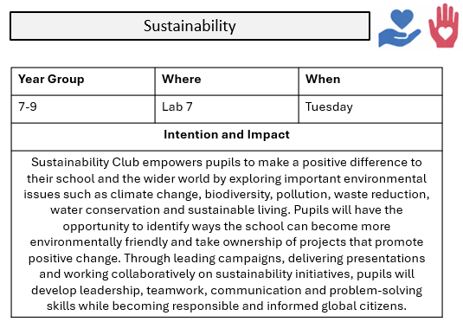
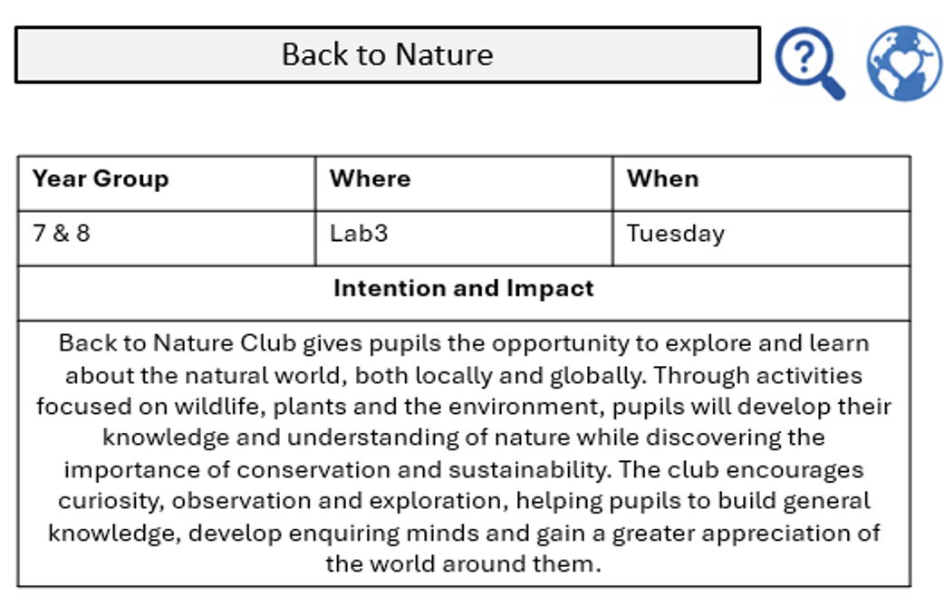

Slide 16
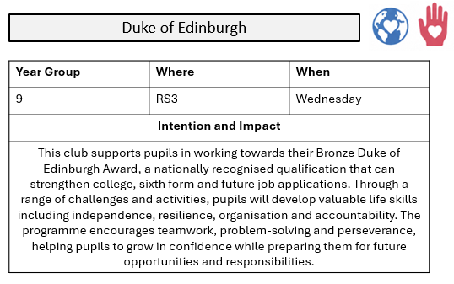

Slide 17
SPORT AND PHYSICAL ACTIVITIES
CLUBS
Other events and activities that will support your involvement in this category are;
Sports Leadership Programme
Inter-School Competitions
County Championships
Sports Tours
School Sports Day
National School Sport Week
Professional Sporting Fixtures
Wimbledon Visit
Cricket T20 Match Visit
Football Stadium Tours
Outdoor Activity Challenges
Colour Run Events
Charity Sports Tournaments
Sports Day

Slide 18
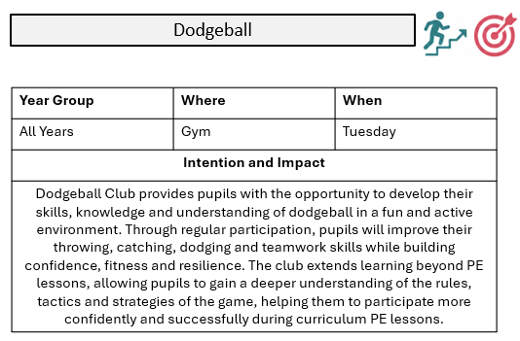
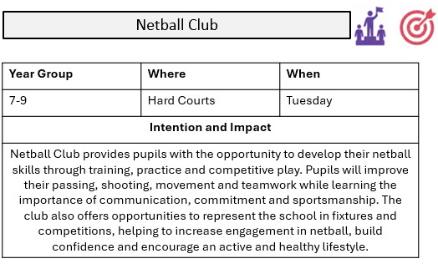

Slide 19
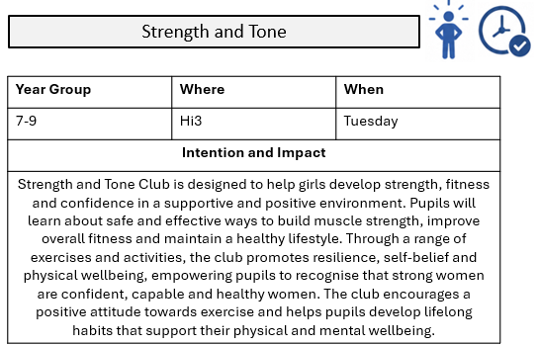
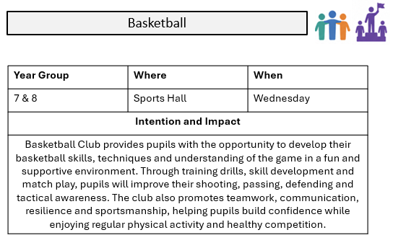

Slide 20
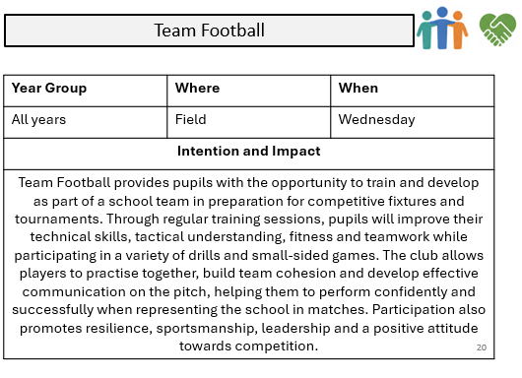
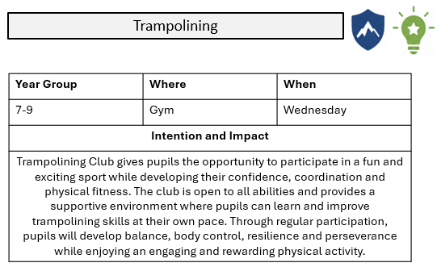

Slide 21
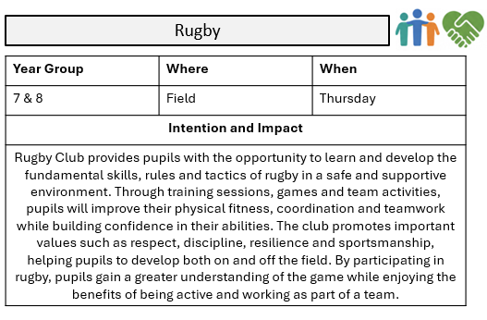
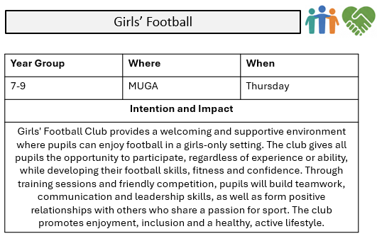

Slide 22
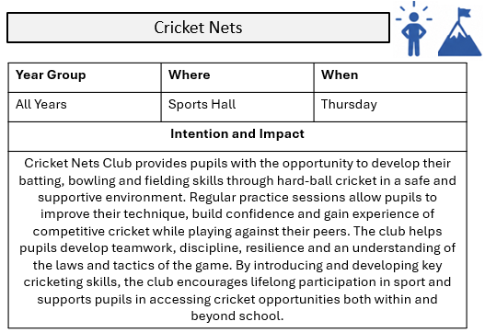
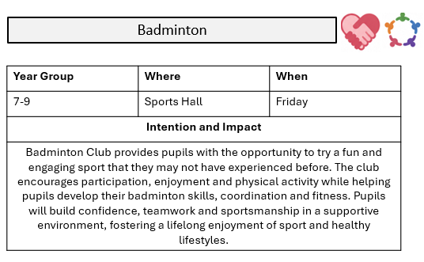

Slide 23
DEVELOPING WIDER LIFE AND FUTURE SKILLS CLUBS
Other events and activities that will support your involvement in this category are;
Enterprise and Dragons' Den Challenge
Financial Literacy Lessons
First Aid Training
Careers Ambassadors
Public Speaking and Presentation Skills - Assemblies
Duke of Edinburgh Skills Section
University Campus Visits
Apprenticeship and Careers Fairs
STEM Industry Visits
Science Museum Visit
Business Enterprise Challenge Days
Mock Interview Events
Workplace Visits
Higher Education Conferences
Coding and Cyber Security Workshops
Careers and Aspirations Week
Employer Networking Events
Life Skills Sessions in PDL
Work Experience
Virtual Work Experience
Restart A Heart Day
i-construct
Employability and Apprenticeship Workshop

Slide 24
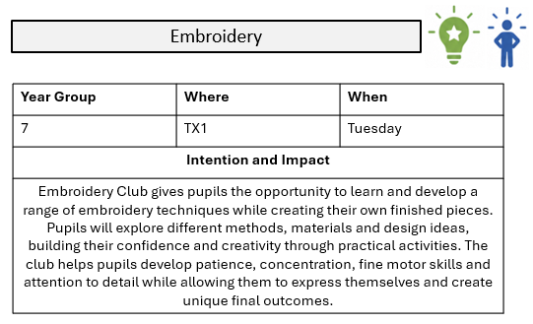
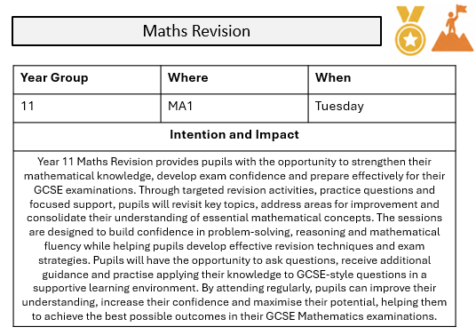

Slide 25
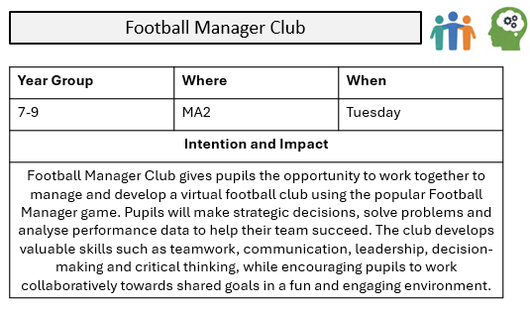
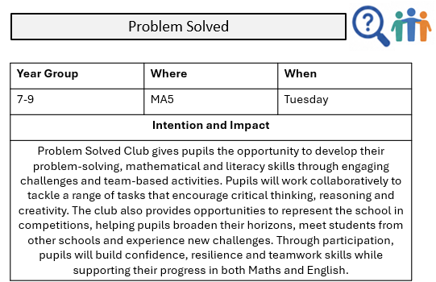

Slide 26
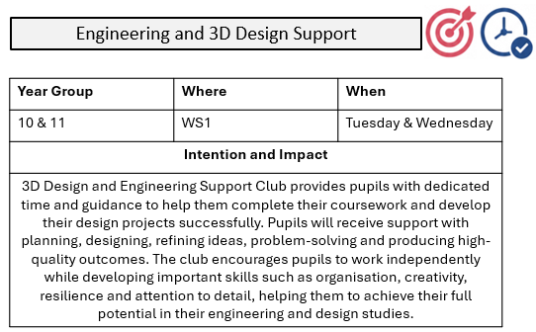
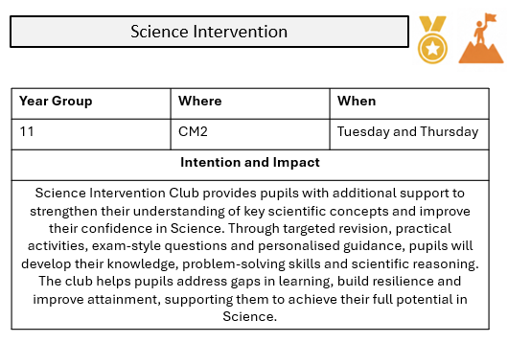

Slide 27
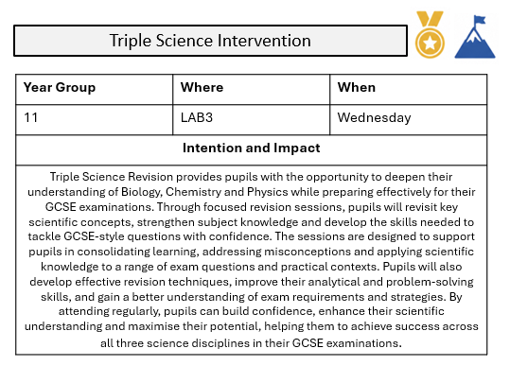
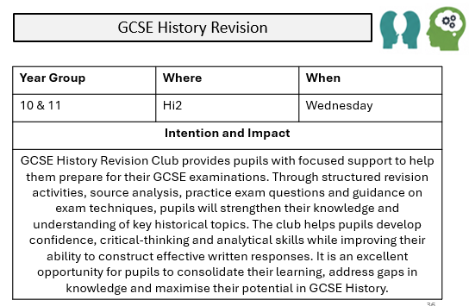

Slide 28
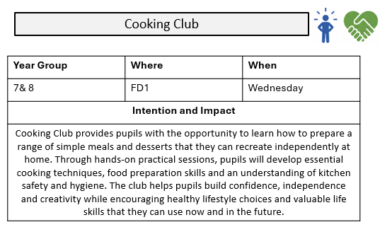
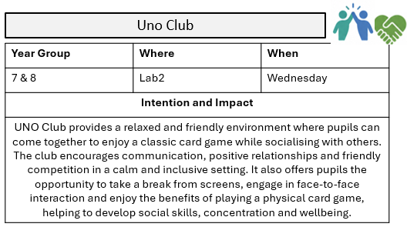

Slide 29

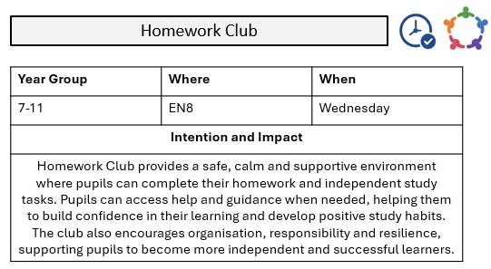

Slide 30
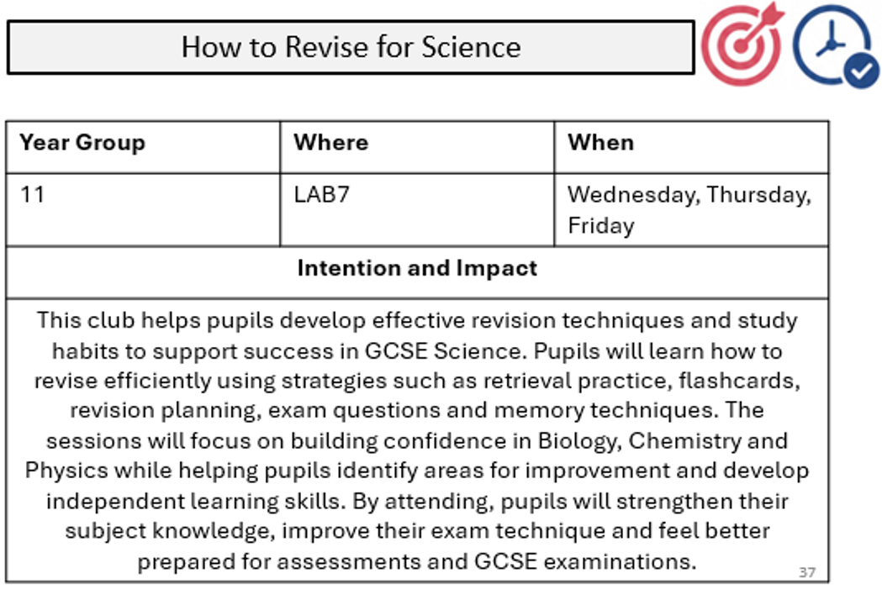
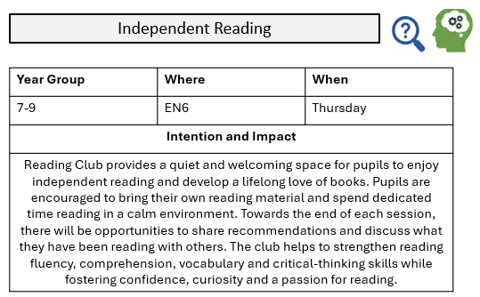

Slide 31

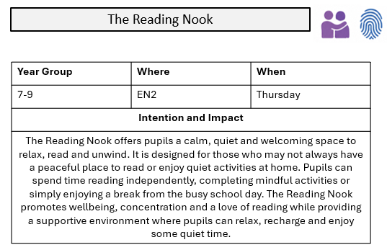

Slide 32

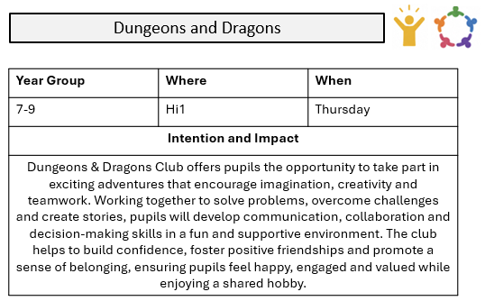

Slide 33
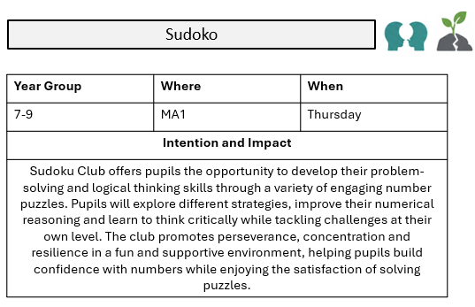
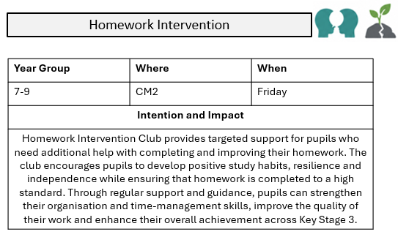

Slide 34
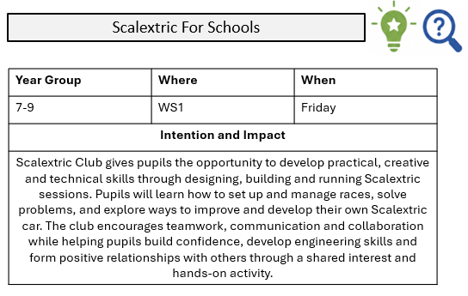

Slide 35
Enrichment Reflection
Which enrichment club(s) did you attend this term? ________________________________________________________________________________________________________________________
What made you decide to join this club? ________________________________________________________________________________________________________________________
How regularly did you attend?
☐ Every session
☐ Most sessions
☐ Some sessions
☐ A few sessions
What was your favourite part of the club and why?
________________________________________________________________________________________________________________________
What new skills or knowledge have you gained through attending? ________________________________________________________________________________________________________________________
Give an example of a time when you demonstrated one of these skills during the club.
________________________________________________________________________________________________________________________

Slide 36
Has attending the club helped you make new friends or strengthen existing friendships? Explain.
__________________________________________________________________________________________________________________________
How has the club helped you outside of enrichment time (e.g. in lessons, at home, in sports, in confidence)?
_____________________________________________________________
Would you recommend this club to another pupil? Why?
________________________________________________________________________________________________________________________
What could be improved about the club?
____________________________________________________________
Are there any new clubs or activities you would like to see offered
next term?
_____________________________________________________________
What other activities did you take part in that count towards your enrichment? (ie trips/workshops/visits etc)
________________________________________________________________________________________________________________________
In one sentence, describe your enrichment experience this term:
_______________________________________________________________________________________________________________________

