Slide 1

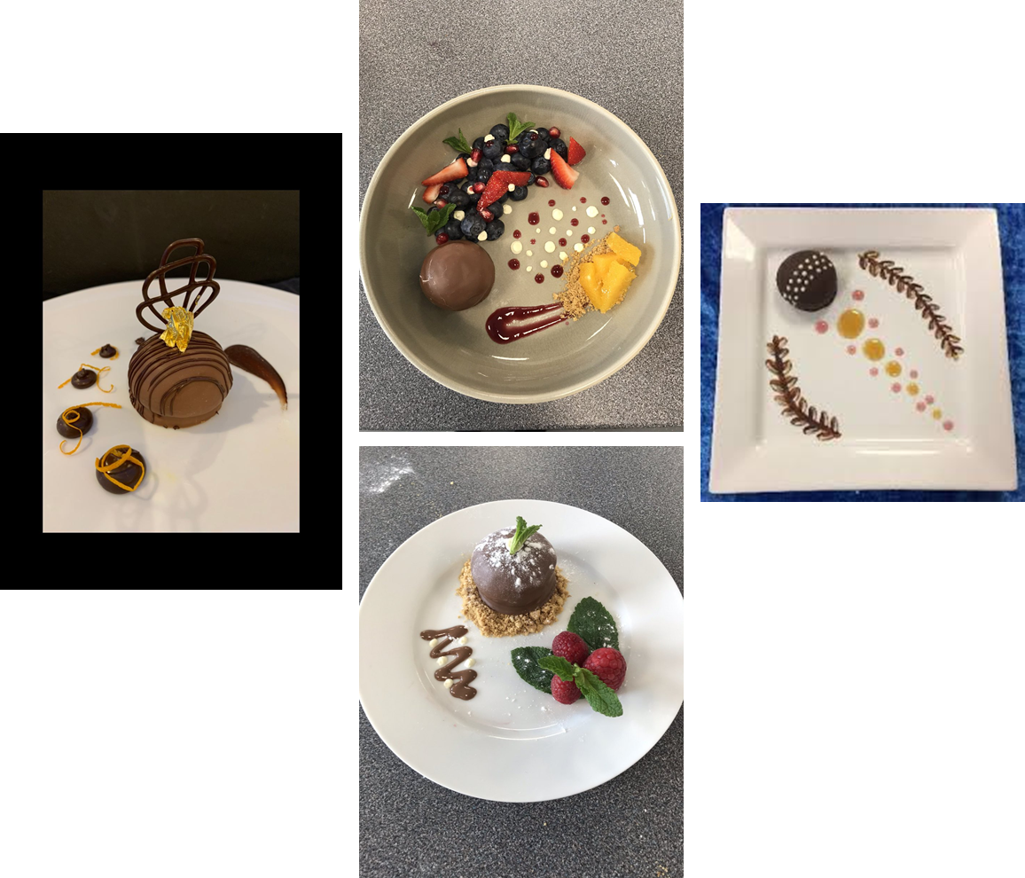
TEA CAKE CHALLENGE
YEAR 8 FOOD PREPARATION & NUTRITION
USING WHAT YOU HAVE IN FRONT OF YOU, CREATE A WELL PRESENTED TEA CAKE
THINK …..
- COLOUR
PLACEMENT
LAYERING
PLATE
ODD NUMBERS
YOU HAVE 25 MINUTES – THIS IS TIMED

Slide 2
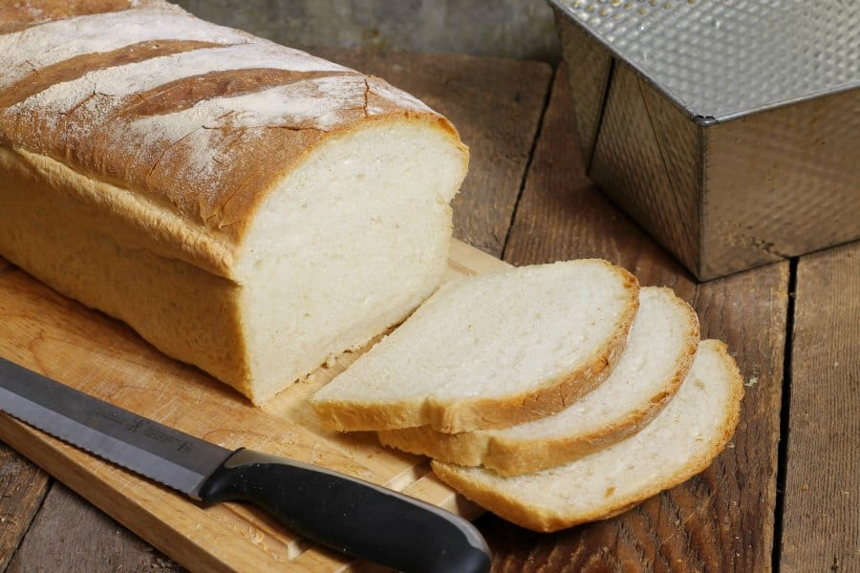

BREAD
METHOD
Pre-heat the oven to 220C Fan or Gas Mark 7
Make the dough by mixing the flour, yeast and salt into a large bowl making a well in the middle.
Measure out the water and add the yeast, mix well. Pour in the mixture to the dry ingredients slowly and adding little bits at a time. Mix until combined to make a wet, pillowy, workable dough.
Tip the dough onto a lightly floured surface and knead for 10 minutes until smooth and elastic.
Place the dough in a clean oiled bowl, cover with clingfilm and leave to rise or doubled in size.
Knock back the dough by tipping it back onto a floured dough and pushing the air out.
Mould the dough to the shape desired, slash the top with a knife if desired.
Cover with a clean tea towel and leave to prove for 30 minutes
Bake the bread for 15 minutes, then reduce the heat to 190C fan or gas mark 5 and continue to bake for 30 minuets until the loaf sounds hollow when removed from the tin and tapped on the base.
Leave the bread on a wire rack to cool
Ingredients
500g Strong White Flour
7g sachet fast-acting yeast
350ml lukewarm water
1tsp oil for greasing
Extra ingredients for flavouring

Slide 3
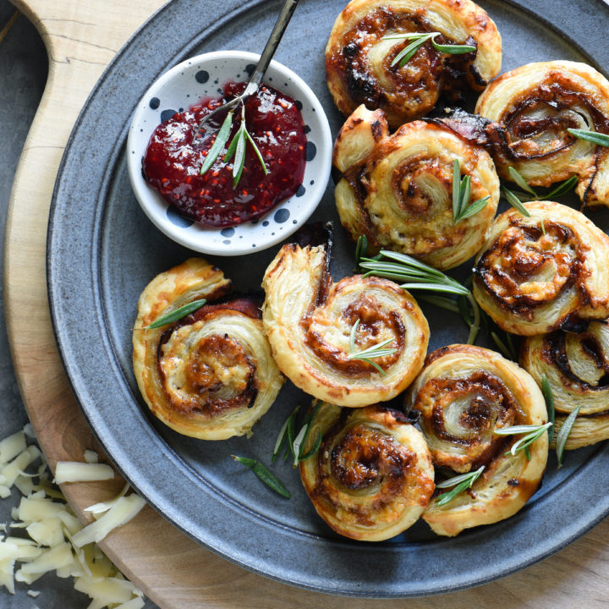
SWEET OR SAVOURY PIN WHEELS
METHOD
Preheat oven to 220C fan/ gas mark 7
Place dry ingredients into a bowl, add in the butter and rub together to create breadcrumbs
Slowly add the water in to the mix using a spoon to make a soft but not sticky dough
Turn onto a floured surface and knead for 10 minutes
Roll into a square roughly 25cm x 25 cm making sure the edges and straight
Spread your sauce over the dough and add toppings, not too many or they will burst out
Roll it up like a swiss roll, tucking the edge in first and rolling up together, then cut into 9 equal sections and place onto a greased baking tray.
Cover and leave in a warm place to rise or until they have doubled in size
Bake for 15 – 20 minutes until golden brown
Ingredients
200g Strong White flour
Extra flour for dusting
1 packet of yeast
1 tsp salt or 1 tsp of sugar
15g Butter
125ml warm water
Sauce
Toppings

Slide 4
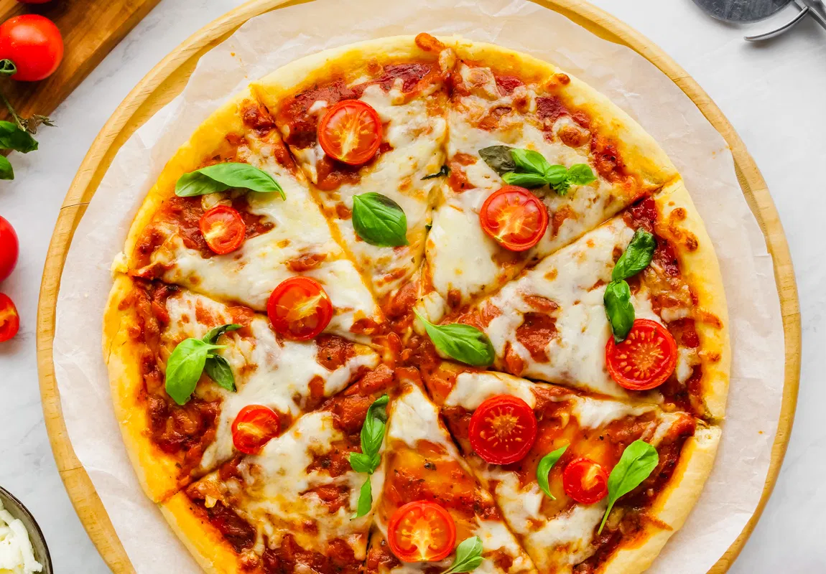
YEAST BASED PIZZA
METHOD
Preheat oven to 200C fan/ gas mark 6
Mix Dry ingredients in a large bowl
Stir in the yeast and make a well in the middle
Combine both the oil and water into a jug before pouring into the bowl
Slowly pour in the mixture and mix well until a ball of dough has formed. Knead for 5 minutes
Grease the baking tray
Roll out and shape the dough into the desired shape and place the dough onto the baking tray
Spread the sauce across the base, leaving a gap for the crust, arrange the toppings on top.
Bake for 10 – 15 minutes
Ingredients
75g Strong White flour
25g Strong Wholemeal flour
Extra flour for dusting
½ tsp salt
1 sachet yeast
1 X 10ml oil
3 tbsp warm water
Tomato puree
Cheese
Toppings of your choice

Slide 5
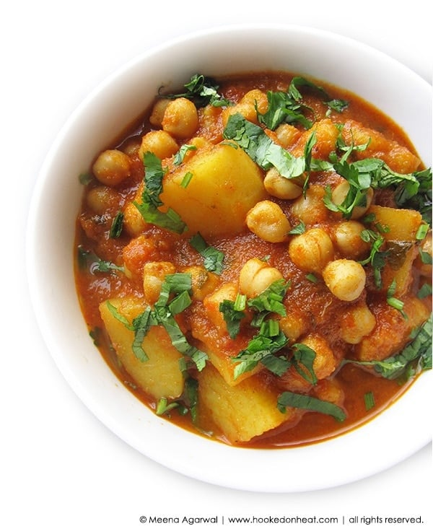
CHICKPEA AND POTATO CURRY
METHOD
In a pan add a pinch of salt and ½ cup of water and gently cook the chickpeas until soft and splitting – 10 minuets
Finely slice the onion, chop the potatoes into small pieces, finely chop the ginger and garlic
Chop up the chillies
In a separate pan heat the oil and fry onion seeds until they start to crackle and then add the fresh onion and fry until brown.
Add in ginger and garlic and fry well, then add 1 tbsp of water
Add the cumin, chilli powder, coriander powder and salt. Fry for 2-3 minuets.
Add chopped tomatoes, fresh chillies and fry for a further 5 minuets
Drain off the chickpeas and add in as well as the chopped tomatoes, add in 2-3tbsp of water, add lemon juice
Garnish with chopped coriander leaves
Ingredients
200g Chickpeas
100g Chopped Tomatoes
50g White Potatoes
½ Medium Onion finely chopped
1cm Fresh Ginger
1 Clove garlic – finely chopped
½ tsp Ground Cumin
1 Green Chillies
1 tsp Coriander Powder
½ tsp Chilli Powder
½ lemon – just the juice
½ tbsp fresh coriander
½ tsp onion seed
2 Cups of water
1 tbsp Olive Oil
Pinch of Salt

Slide 6

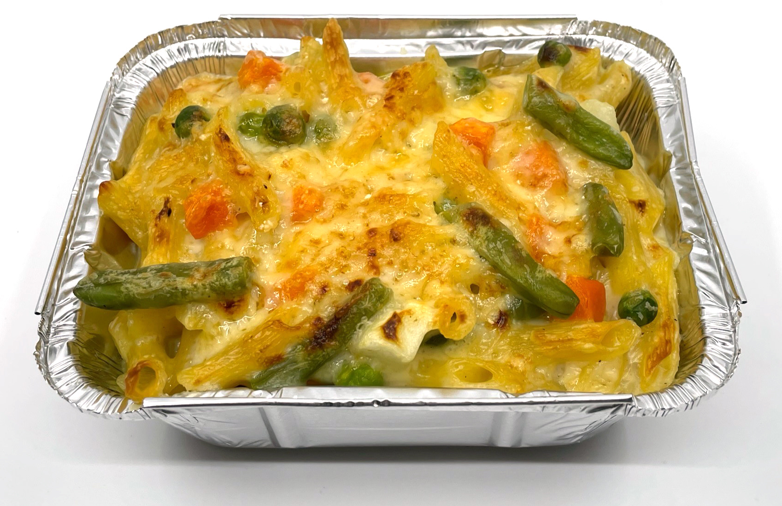
MAC, VEG ‘N’ CHEESE
METHOD
1. Bring a saucepan of water to the boil, and then add the macaroni. Cook for about 10-12 minutes, until al dente. Add the frozen vegetables 5 mins before the end.
2. Grate the cheese.
3. While the pasta is cooking, make the sauce:
• place the fat, flour and milk into a small saucepan;
• bring the sauce to a boil, whisking all the time until it has thickened;
• stir in 20g of the grated cheese and mustard or mustard powder;
• simmer for 2-3 mins.
4. Preheat the grill.
5. Drain the boiling hot water away from the macaroni using a colander over a sink.
6. Stir the macaroni into the cheese sauce and add a few twists of black pepper.
7. Pour the macaroni into a foil tray/dish.
8. Sprinkle the remaining cheese over the top.
9. Place under a hot grill until the cheese is bubbling and golden brown.
Ingredients
100g Macaroni
100g frozen mixed veg
60g Cheddar Cheese
25g Butter
25g Plain flour
250ml Semi-Skimmed Milk
Black Pepper
1 tsp Mustard or Mustard Powder

Slide 7
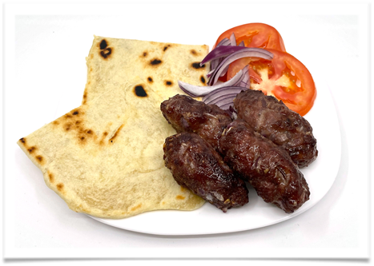
KOFTAS WITH FLATBREAD
METHOD
1. Preheat the grill and line the baking tray with foil.
2. Make the flatbreads:
• mix the flour, water, oil and salt together to form a dough;
• knead for 3-4 mins, then cover and leave.
3. Make the koftas:
• peel and chop the garlic;
• peel and chop ½ of the red onion;
• mix the beef mince, garlic, ground coriander, cumin and chilli flakes together;
• form into 4 koftas and place on the baking tray and grill for 15-20 mins, turning occasionally.
4. While the koftas cook, prepare the simple salad garnish:
• peel and slice the remaining ¼ red onion;
• slice the tomato.
5. Cook the flatbreads:
• heat the frying pan;
• divide the dough into 2 and roll-out into oblongs;
• brush with a little oil;
• place the dough in the pan and fry for 2-3 mins each side, until brown (turn with tongs).
Ingredients
150g Mince Beef
1 x Clove of Garlic
½ tsp Ground Coriander
½ tsp Cumin
Pinch of Chilli flakes
½ red onion
1 tomato
100g plain flour
50ml water
1 tbsp Oil

Slide 8
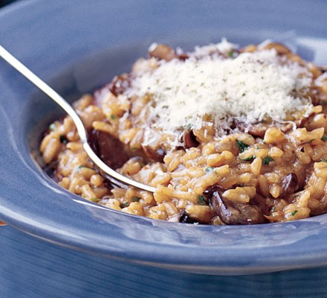
RISOTTO
METHOD
1. Put mushrooms into a large bowl and pour over 1 litre boiling water. Soak for 20 mins, then drain into a bowl, discarding the last few tbsp of liquid left in the bowl.
2. Crumble 1 vegetable stock cube into the mushroom liquid, then squeeze the mushrooms gently to remove any liquid.
3. Heat 2 tbsp olive oil in a shallow saucepan or deep frying pan over a medium flame. Add 1 finely chopped onion and 2 finely chopped garlic cloves, then fry for about 5 mins until soft.
4. Stir in 250g chopped chestnut mushrooms, season with salt and pepper and continue to cook for 8 mins until the fresh mushrooms have softened.
5. Tip risotto rice into the pan and cook for 1 min. Fry off bacon in a separate frying pan.
6. Keep the pan over a medium heat and pour in a quarter of the stock. Simmer the rice, stirring often, until the rice has absorbed all the liquid.
7. Add about the same amount of stock again and continue to simmer and stir - it should start to become creamy, plump and tender. By the time the final quarter of stock is added, the rice should be almost cooked.
8. Continue stirring until the rice is cooked. If the rice is still undercooked, add a splash of water. Take the pan off the heat, add 25g butter and scatter over 10g grated parmesan and half a handful of chopped parsley leaves.
9. Cover and leave for a few mins so that the rice can take up any excess liquid as it cools a bit. Give the risotto a final stir, spoon into bowls and scatter with the remaining 10g grated cheese and the remaining chopped parsley leaves.
Ingredients
1tbsp Olive Oil
1 Onion
4 Streaky Bacon
125g Chestnut Mushrooms
150g Risotto Rice
1 Chicken Stock cube
20g Grated Parmesan
25g butter
2 Cloves Garlic
Fresh parsley

Slide 9
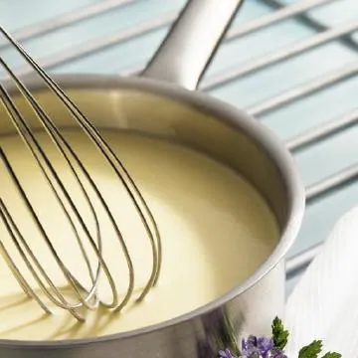
BASIC WHITE SAUCE
METHOD
Prepare self and work area for practical
Collect equipment and weigh and prepare ingredients
Gently melt the margarine in a saucepan over a low heat
Stir in the flour and cook for 1-2 minutes
Take the pan off the heat and gradually stir in the milk to get a smooth sauce. Return to the heat and, whisking all the time, bring to the boil
Keep whisking until the sauce is lump free and glossy
Add in the salt/pepper/herbs cheese
When finished, wash up your equipment and clean your work areas.
Ingredients
25g soft margarine
25g plain flour
250ml semi-skimmed milk
Black pepper
Half tbsp herbs/spices
Extra ingredients, IE: ham, bacon, onion, cheese, pasta etc whatever you decide!

Slide 10
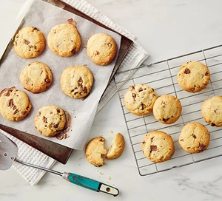
BASIC COOKIES
METHOD
Heat the oven to 190C/170C fan/gas 5.
Cream the butter in a large bowl with a wooden spoon until it is soft. Add the sugar and keep beating until the mixture is light and fluffy.
Sift in the flour and add the chocolate chips. Bring the mixture together with your hands in a figure-of-eight motion until it forms a dough.
Roll the dough into walnut-sized balls and place them slightly apart from each other on a baking sheet
Flatten the balls a little with the palm of your hand and bake them in the oven for around 10-12 mins until they are golden brown and slightly firm on top.
Leave the cookies on a cooling rack for around 15 mins before serving.
Ingredients
113g Butter
55g Caster Sugar
138g Plain Flour
38g Chocolate Chips
This is an investigation around fats each person in your group will look at different forms of butter

