Slide 1
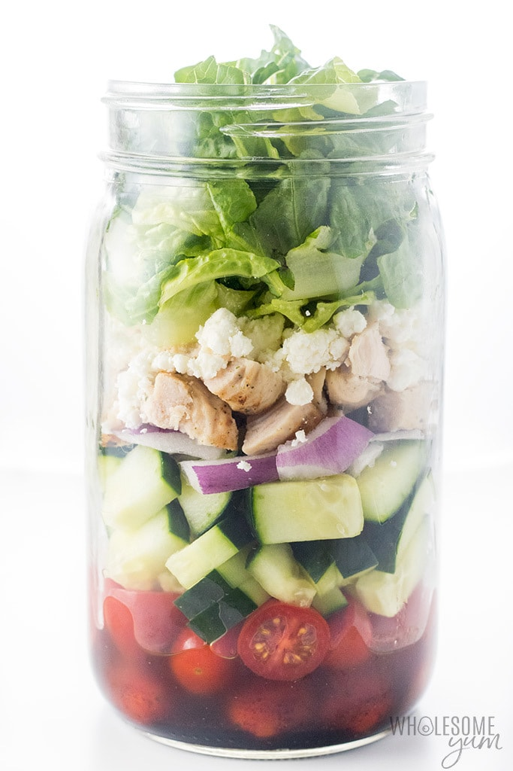

MEAL IN A JAR
METHOD
Prepare self and work area for practical
Cook off any meats or alternative in a frying pan ensuring they are fully cooked
Using a knife carefully and start to prepare your salad options by chopping and slicing them up
Once all your options are ready assemble all on a chopping board
Wash your jar up making sure it is clean
Start to layer your salad options, your meat and your sauce try and alternate colours!
Ingredients
1 X Sauce of your choice
4 X different salad options
1 X meat or alternative
We will cook and prepare everything in class.

Slide 2
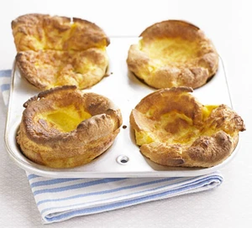
YORKSHIRE PUDDINGS
METHOD
Heat oven to 230C/fan 210C/gas 8.
Drizzle a little sunflower oil evenly into two 4-hole Yorkshire pudding tins or two 12-hole non-stick muffin tins and place in the oven to heat through.
To make the batter, tip 140g plain flour into a bowl and beat in 4 eggs until smooth.
Gradually add 200ml milk and carry on beating until the mix is completely lump-free. Season with salt and pepper.
Pour the batter into a jug, then remove the hot tins from the oven. Carefully and evenly pour the batter into the holes.
Place the tins back in the oven and leave undisturbed for 20-25 mins until the puddings have puffed up and browned.
Ingredients
140g plain flour (this is about 200ml/7fl oz)
4 eggs (200ml/7fl oz)
200ml milk
sunflower oil , for cooking

Slide 3
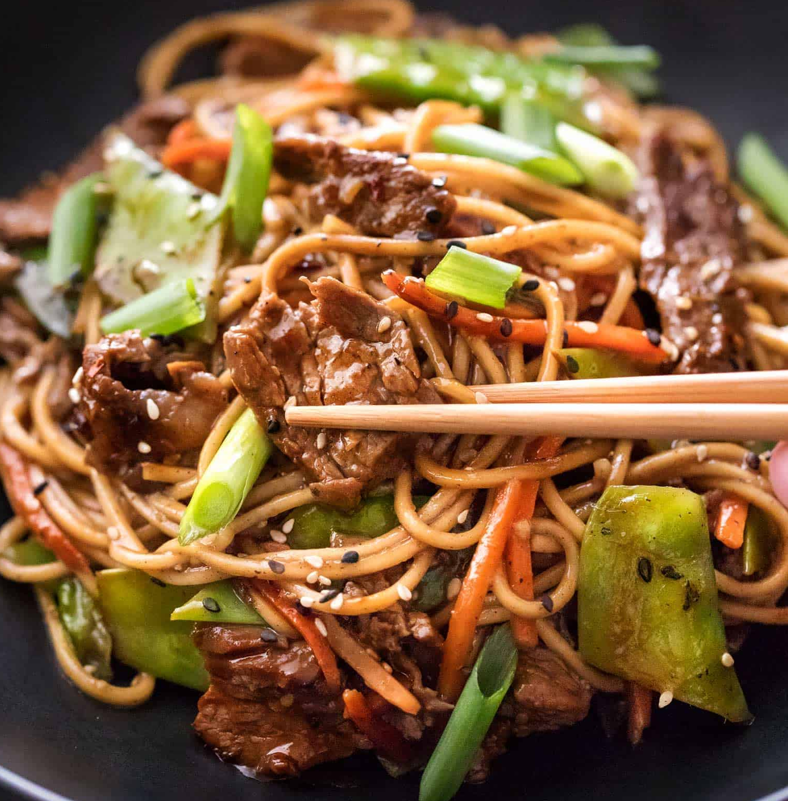
STIR FRY
Method
1. Cook the noodles in boiling water. Check the packet for details
2. Prepare the vegetables with a clean knife on a clean chopping board:
3. peel and crush the garlic; de-seed and slice the chilli; peel and slice the ginger; slice the onion, pepper and mushrooms. On a different board, finely slice the chicken breast
4. Heat the oil in a wok or frying pan.
5. Add the onion, garlic, chilli and ginger. Allow to cook for 1 minute. Add the chicken and fry for 5 minutes
6. Add the remaining vegetables and soy sauce and continue to cook for a further 5 minutes.
CHECK THE CHICKEN IS COOKED BEFORE ADDING NOODLES
8. Drain the boiling hot water away from the noodles into a colander in the sink.
9. Stir in the cooked noodles and cook for 2 minutes until hot.
10. Serve. Clear up
Ingredients
100g noodles 1 small chicken breast 1 clove garlic ½ or 1 red chilli 1cm fresh ginger ½ or 1 small onion 3 mushrooms ½ or 1 pepper 1 x 10ml spoon oil 1 x 10ml spoon soy sauce (reduced salt) 2X Sweet chili sauce (optional)

Slide 4
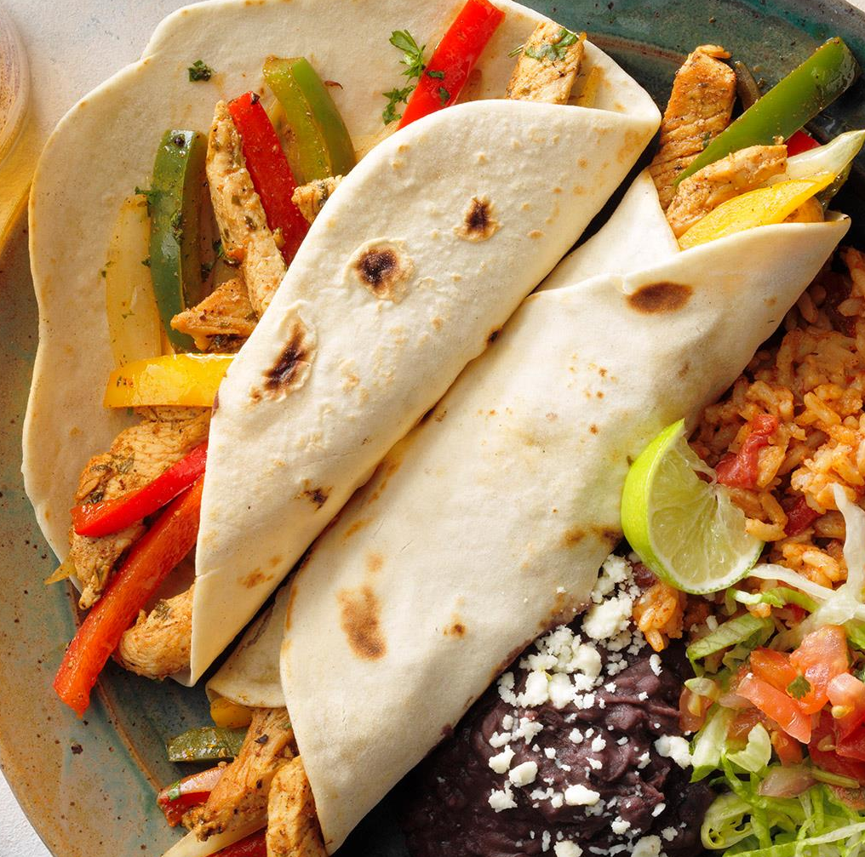
FAJITAS
Method
Prepare the marinade:
squeeze the lime; peel and crush the garlic; de-seed and slice the chilli; chop the coriander
stir everything together with the oil.
2. Remove any skin from the chicken and cut the chicken into strips. Mix with the marinade and place in the fridge, covered, until needed.
3. Prepare the remaining ingredients with a clean knife on a clean chopping board:
slice the onion and green pepper; chop the tomato; grate the cheese
5. Add the marinated chicken to the wok or saucepan and stir-fry for about 4 minutes. Check that the chicken is cooked.
6. Add the onion and green pepper and continue to cook for a further 2 minutes.
7. Spread a little chicken in the center of the tortilla, add some tomato, cheese and guacamole, then roll up.
8. Serve and eat
Ingredients
1 lime
1 clove garlic
½ green chilli
Small bunch of coriander
1 x 10ml spoon oil
1 small chicken breast
(or 3 – 4 thighs)
½ onion
½ green pepper
1 tomato
25g Cheddar cheese
2 tortillas
1 x 15ml spoon guacamole (or salsa), optional

Slide 5

EGGS
BOILED METHOD
POACHED METHOD
Boil the kettle
Once boiled add the water to a saucepan with 2 X tablespoons of vinegar
Swirl the water around until a whirlpool is created.
Crack the egg in the middle of the whirlpool
Boil the kettle
Once boiled add the water to the saucepan
Add the whole egg into the pan (do not crack the egg)
Once done, run under cold water until touchable.
Then peel off the shell
Ingredients
2 Eggs each
On your tables each person will cook their eggs in a different way. You will all present your eggs on the SAME plate then taste and analyse the different cooking methods
FRIED METHOD
SCRAMBLED METHOD
Add oil to a frying pan
Once warm crack the egg into the corner of the frying pan
Cook until it is a solid colour and the edges are crispy
Crack the egg into a bowl
Add a splash of milk and a knob of butter
Whisk together until combined
Pop in the microwave for 30second intervals

Slide 6
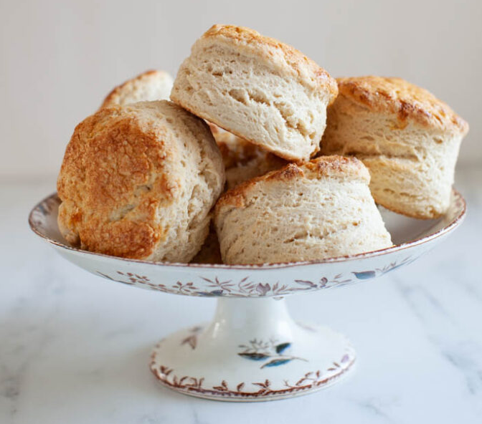
SCONES
METHOD
1. Heat the oven to 220C/200C Fan/430F and place a lined baking tray in the oven to preheat.
2.Tip the flour, salt, baking powder and butter into a bowl and rub together until it resembles bread crumbs - Pour the mixture into a bowl and stir in the sugar and add alternative ingredients.
Alternatively, rub the butter into the flour mixture till breadcrumbs are formed. Add the lemon juice to the dry mixture!
3. Heat the Milk in the microwave or on the hob so its warm but not hot - microwave will take about 30 seconds - you don't want it too hot!
4. Add the vanilla to the milk and mix.
5. Make a well in the dry mixture and add the liquid - stir with a spatula as it will be very wet at first - but it'll soon dry out as the liquid is incorporated.
6. Dust the work surface with some flour and tip the dough onto it - fold the dough over a few times so it is smooth but do not over work it!
7. Roll the dough out till it is about 4cm thick.
8. Dip a 5cm round cutter into the spare flour and cut out the scones - you will probably get four out of the first go! Repeat this again till you finish up all the dough!
9. Take the tray out of the oven carefully and place the scones onto it - brush the tops with the beaten egg so its glazed and bake in the oven for 10 minutes - leave to cool slightly when baked.
Ingredients 90 g Unsalted Butter (cold/cubed) 1 tsp Baking Powder 350 g Self Raising Flour (plus extra for dusting) 50 g Caster Sugar 1 tsp Lemon Juice 180 ml Milk 1 tsp Vanilla Extract 1 Egg (to glaze) 80g additional ingredients

Slide 7
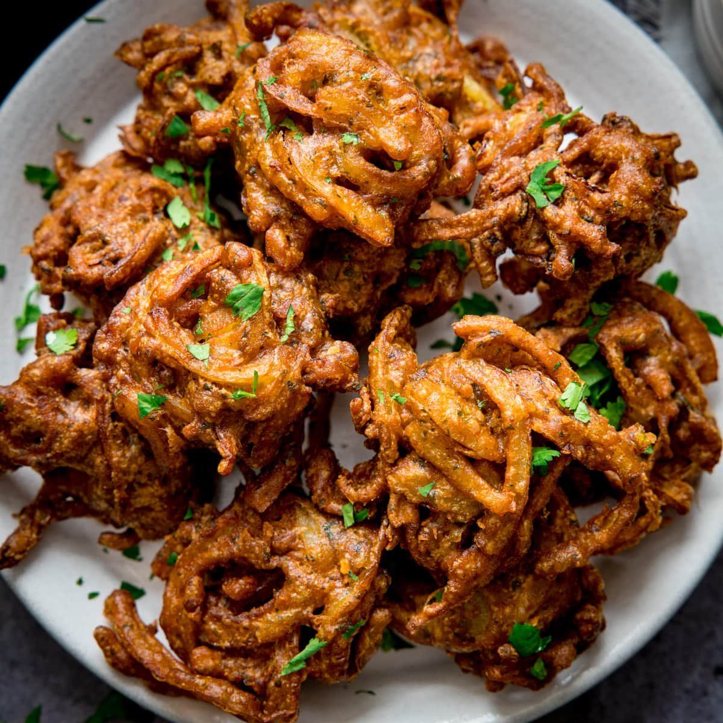
ONION BHAJI
METHOD
1. Sieve the gram flour, chilli powder and salt together
2. Beat the eggs in a separate bowl
3. Mix the eggs into the flour mixture with the water and beat it into a smooth consistent paste
4. Add the thinly sliced onion and thinly sliced potato (grated is better)
5. Fold the onion and potato into the paste
6. Make walnut sized balls with the tbsp and fry in the oil for 2-3 minuets, turn the heat down and cook until golden brown
7. Drain and serve
Ingredients
75g Gram Flour (ground chickpeas)
38ml Water
2 Medium Onions thinly sliced
½ tsp Chilli Powder
1 Large Eggs
½ Medium potato – Grated
Pinch of Salt

Slide 8
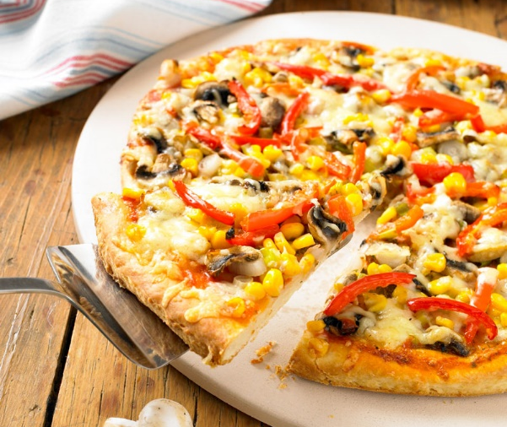
SCONE BASED PIZZA
METHOD
1. Prepare yourself and your work area and collect your ingredients and equipment.
2. Light the oven Gas Mk7/210C fan. Grease a baking tray.
3. Put the flour and margarine into a mixing bowl and rub together until like fine breadcrumbs.
4. Beat together the egg and the milk and use to add to the flour mixture to make a soft but not sticky dough.
5. Gather into a ball and roll out on a floured surface to about 2cms thick. Place on the baking tray.
6. Spoon the tomato sauce carefully over the pizza base, before adding the rest of the ingredients.
7. Finish with the grated cheese and any raw meat, if you are using it.
(e.g. bacon)
8. Place in the centre of the pre-heated oven for about 15-20 minutes,
until risen and golden.
Ingredients
150g Self Raising Flour
25g Butter/Margarine
1 egg
50ml semi-skimmed milk
Tomato puree
4 X toppings of choice
50g Grated Mozzarella
1 tsp herbs

Slide 9

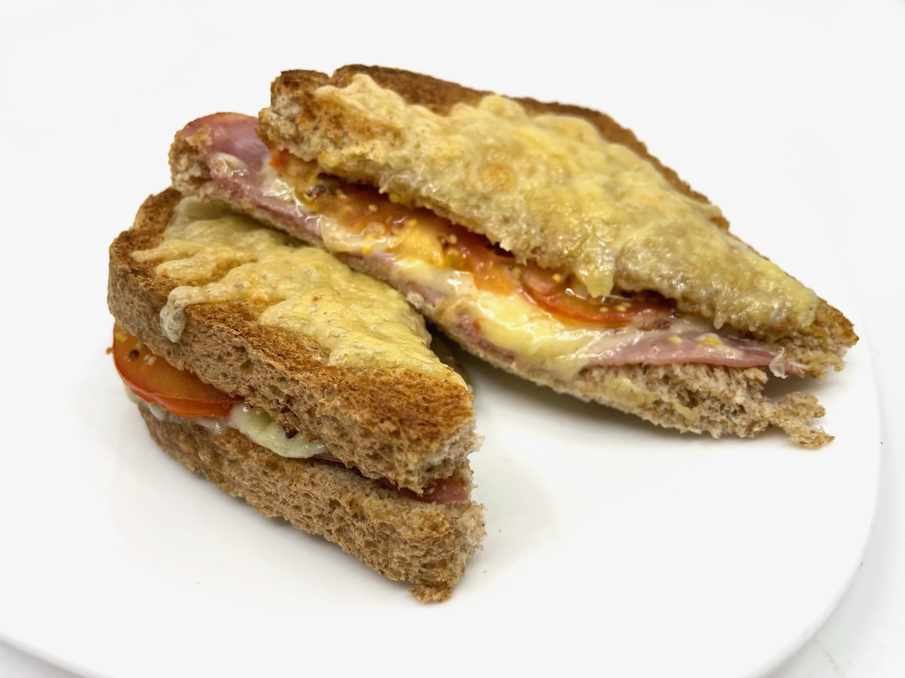
CROQUE MONSIEUR
METHOD
Pre-heat the grill.
Grate the cheese and divide into 3 portions.
Slice the tomato.
Place the bread on the chopping board.
Spread the mustard and tomato slices on one slice of bread, and top with 1 portion of cheese.
Place the ham on the other slide, and top with 1 portion of cheese.
Place under the grill, removing when bubbling hot.
Press the 2 slices of bread together and sprinkle the remaining cheese on top.
Place undertaking the grill until the cheese is melted.
Ingredients
30g Cheddar Cheese
½ Tomato
2 Slices of Bread
2.5ml Mustard
1 slice of Ham (meat or veggie)

Slide 10
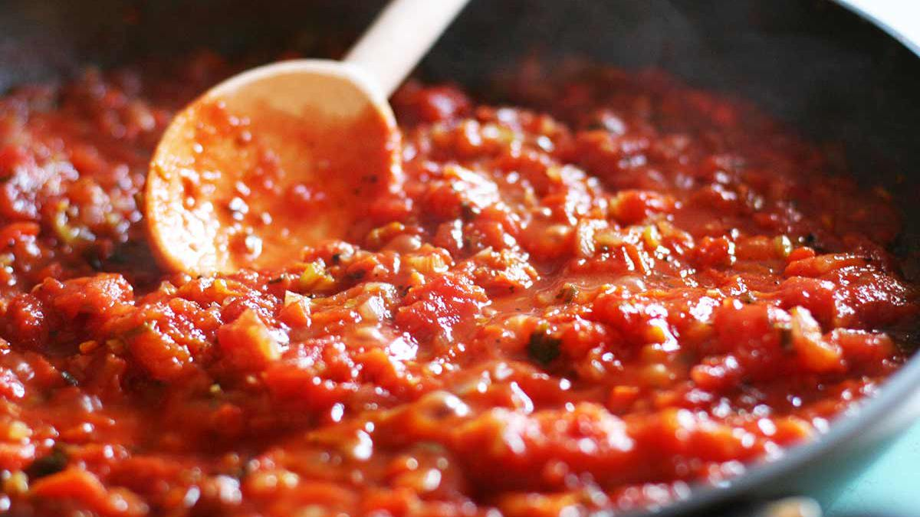
BASIC TOMATO SAUCE
METHOD
Peel and chop the onion, dicing it into small chunks. After this peel and crush the garlic using a garlic crusher.
Fry the onion and garlic in the oil for 5 minutes until soft, on a medium heat. Fry any other ingredients off at this point also.
Add the tomatoes and tear in the basil leaves in.
Add a few twists of black pepper, then allow to simmer gently for 20 minutes.
While onion and garlic is frying, boil kettle and pour into pan. Turn on hob and bring to boil. When rapidly boiling, add the pasta and cook for around 10 minutes until al dente,
Prepare any other vegetables or meat needed for the dish
When done, drain pasta using a colander in the sink. Mix the cooked pasta and tomato sauce together then present your dish.
Ingredients
1 onion
1 clove garlic
1 x 15ml spoon oil
1 x 400g canned chopped tomatoes
Handful of fresh basil
Black pepper
100g pasta

Slide 11
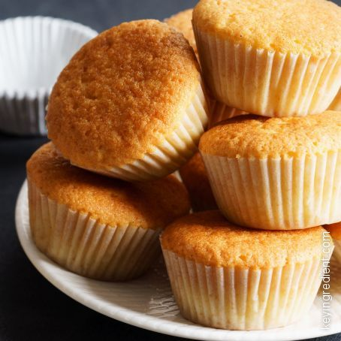
BASIC CUPCAKES
METHOD
Heat oven to 180C/160C fan/gas 4 and fill a 12 cupcake tray with cases.
Beat the softened butter and the sugar together until pale and fluffy.
Whisk in 2 large eggs, one at a time, scraping down the sides of the bowl after each addition.
Add ½ tsp vanilla extract, 110g self-raising flour and a pinch of salt, whisk until just combined then spoon the mixture into the cupcake cases.
Bake for 15 mins until golden brown and a skewer inserted into the middle of each cake comes out clean.
Leave to cool completely on a wire rack.
Ingredients
110g softened butter
110g sugar
2 large eggs
½ tsp vanilla extract
110g self-raising flour
12 Cupcake cases
This is an investigation around sugars each person in your group will look at different sugars

