Slide 1
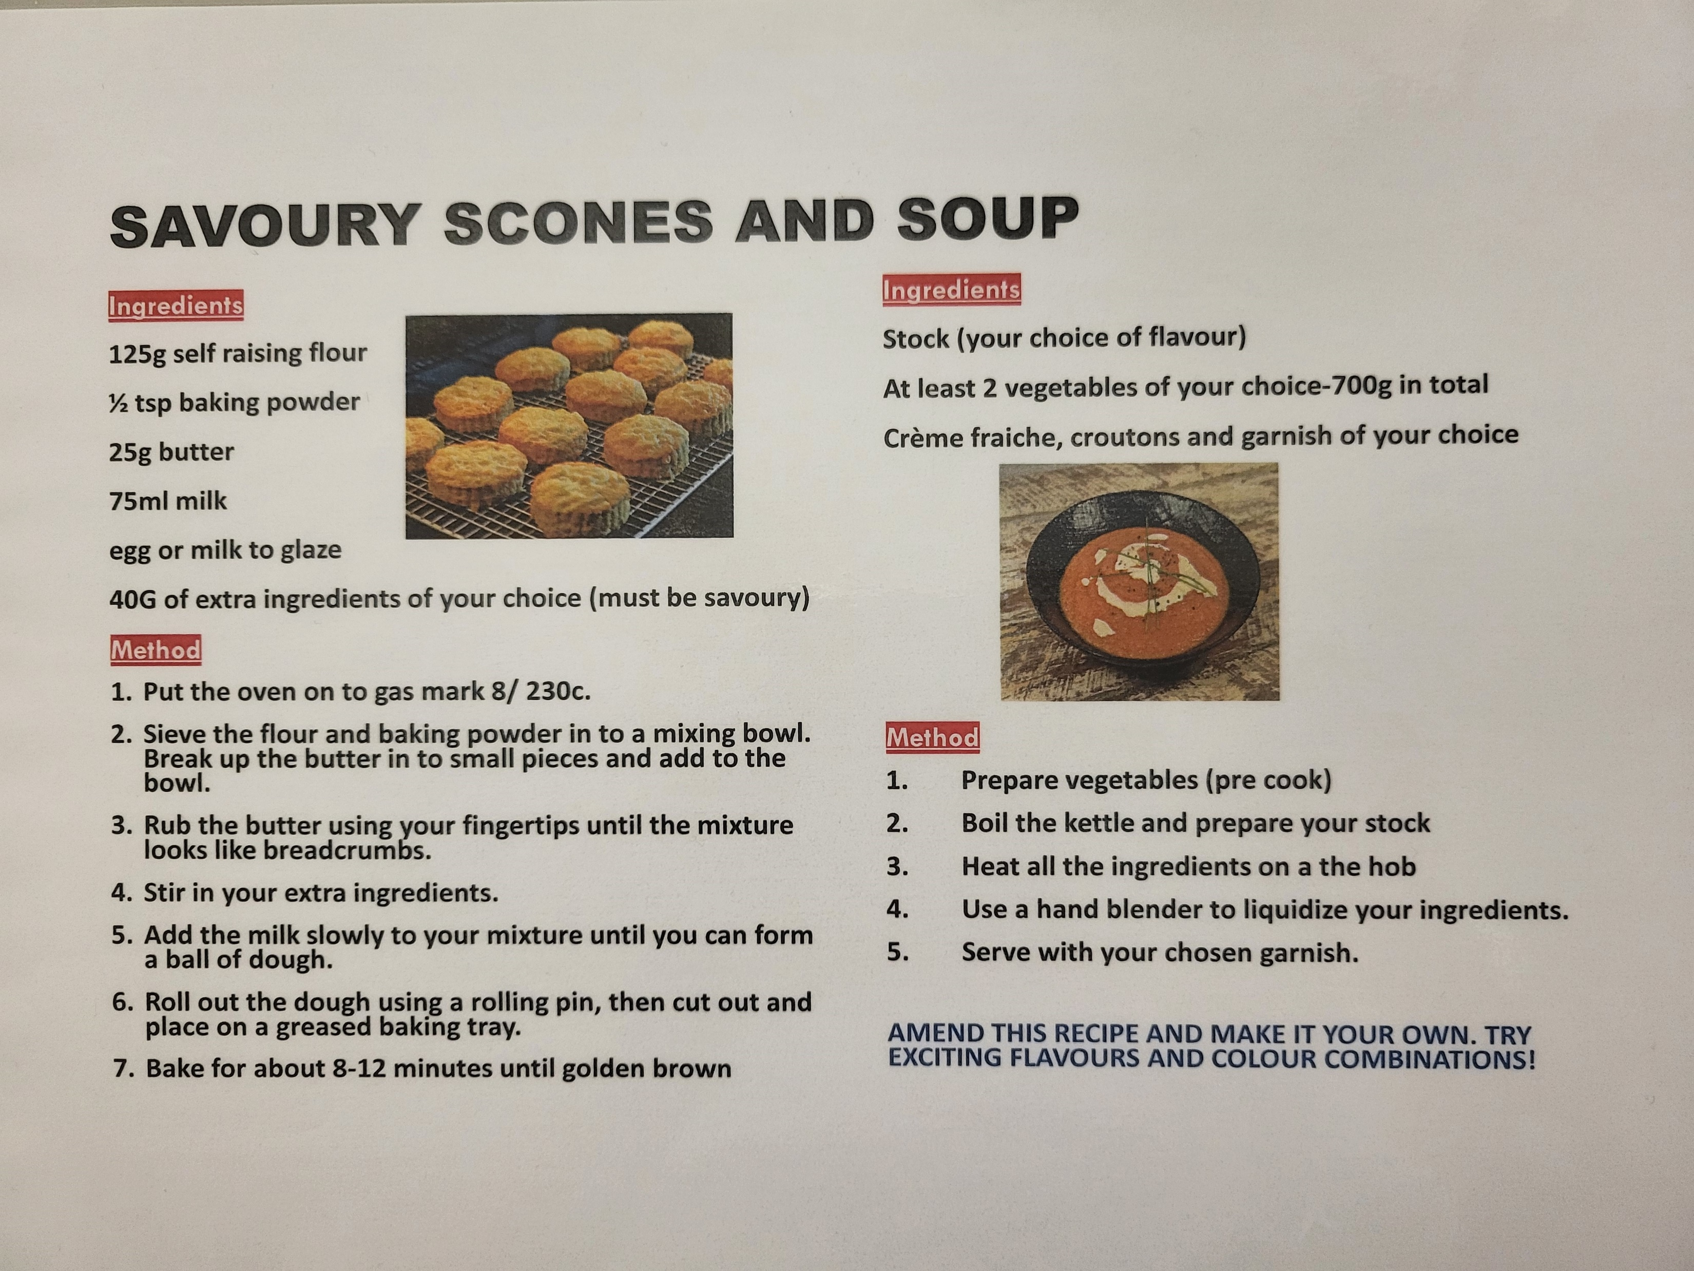

Slide 2
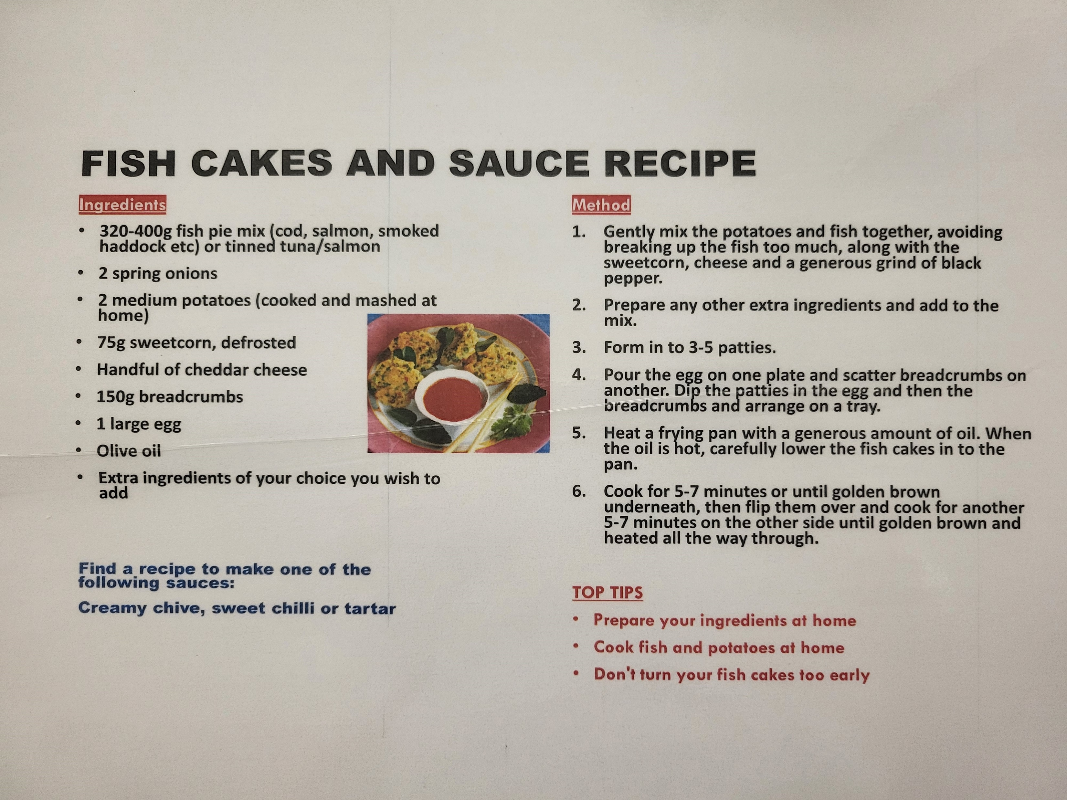

Slide 3
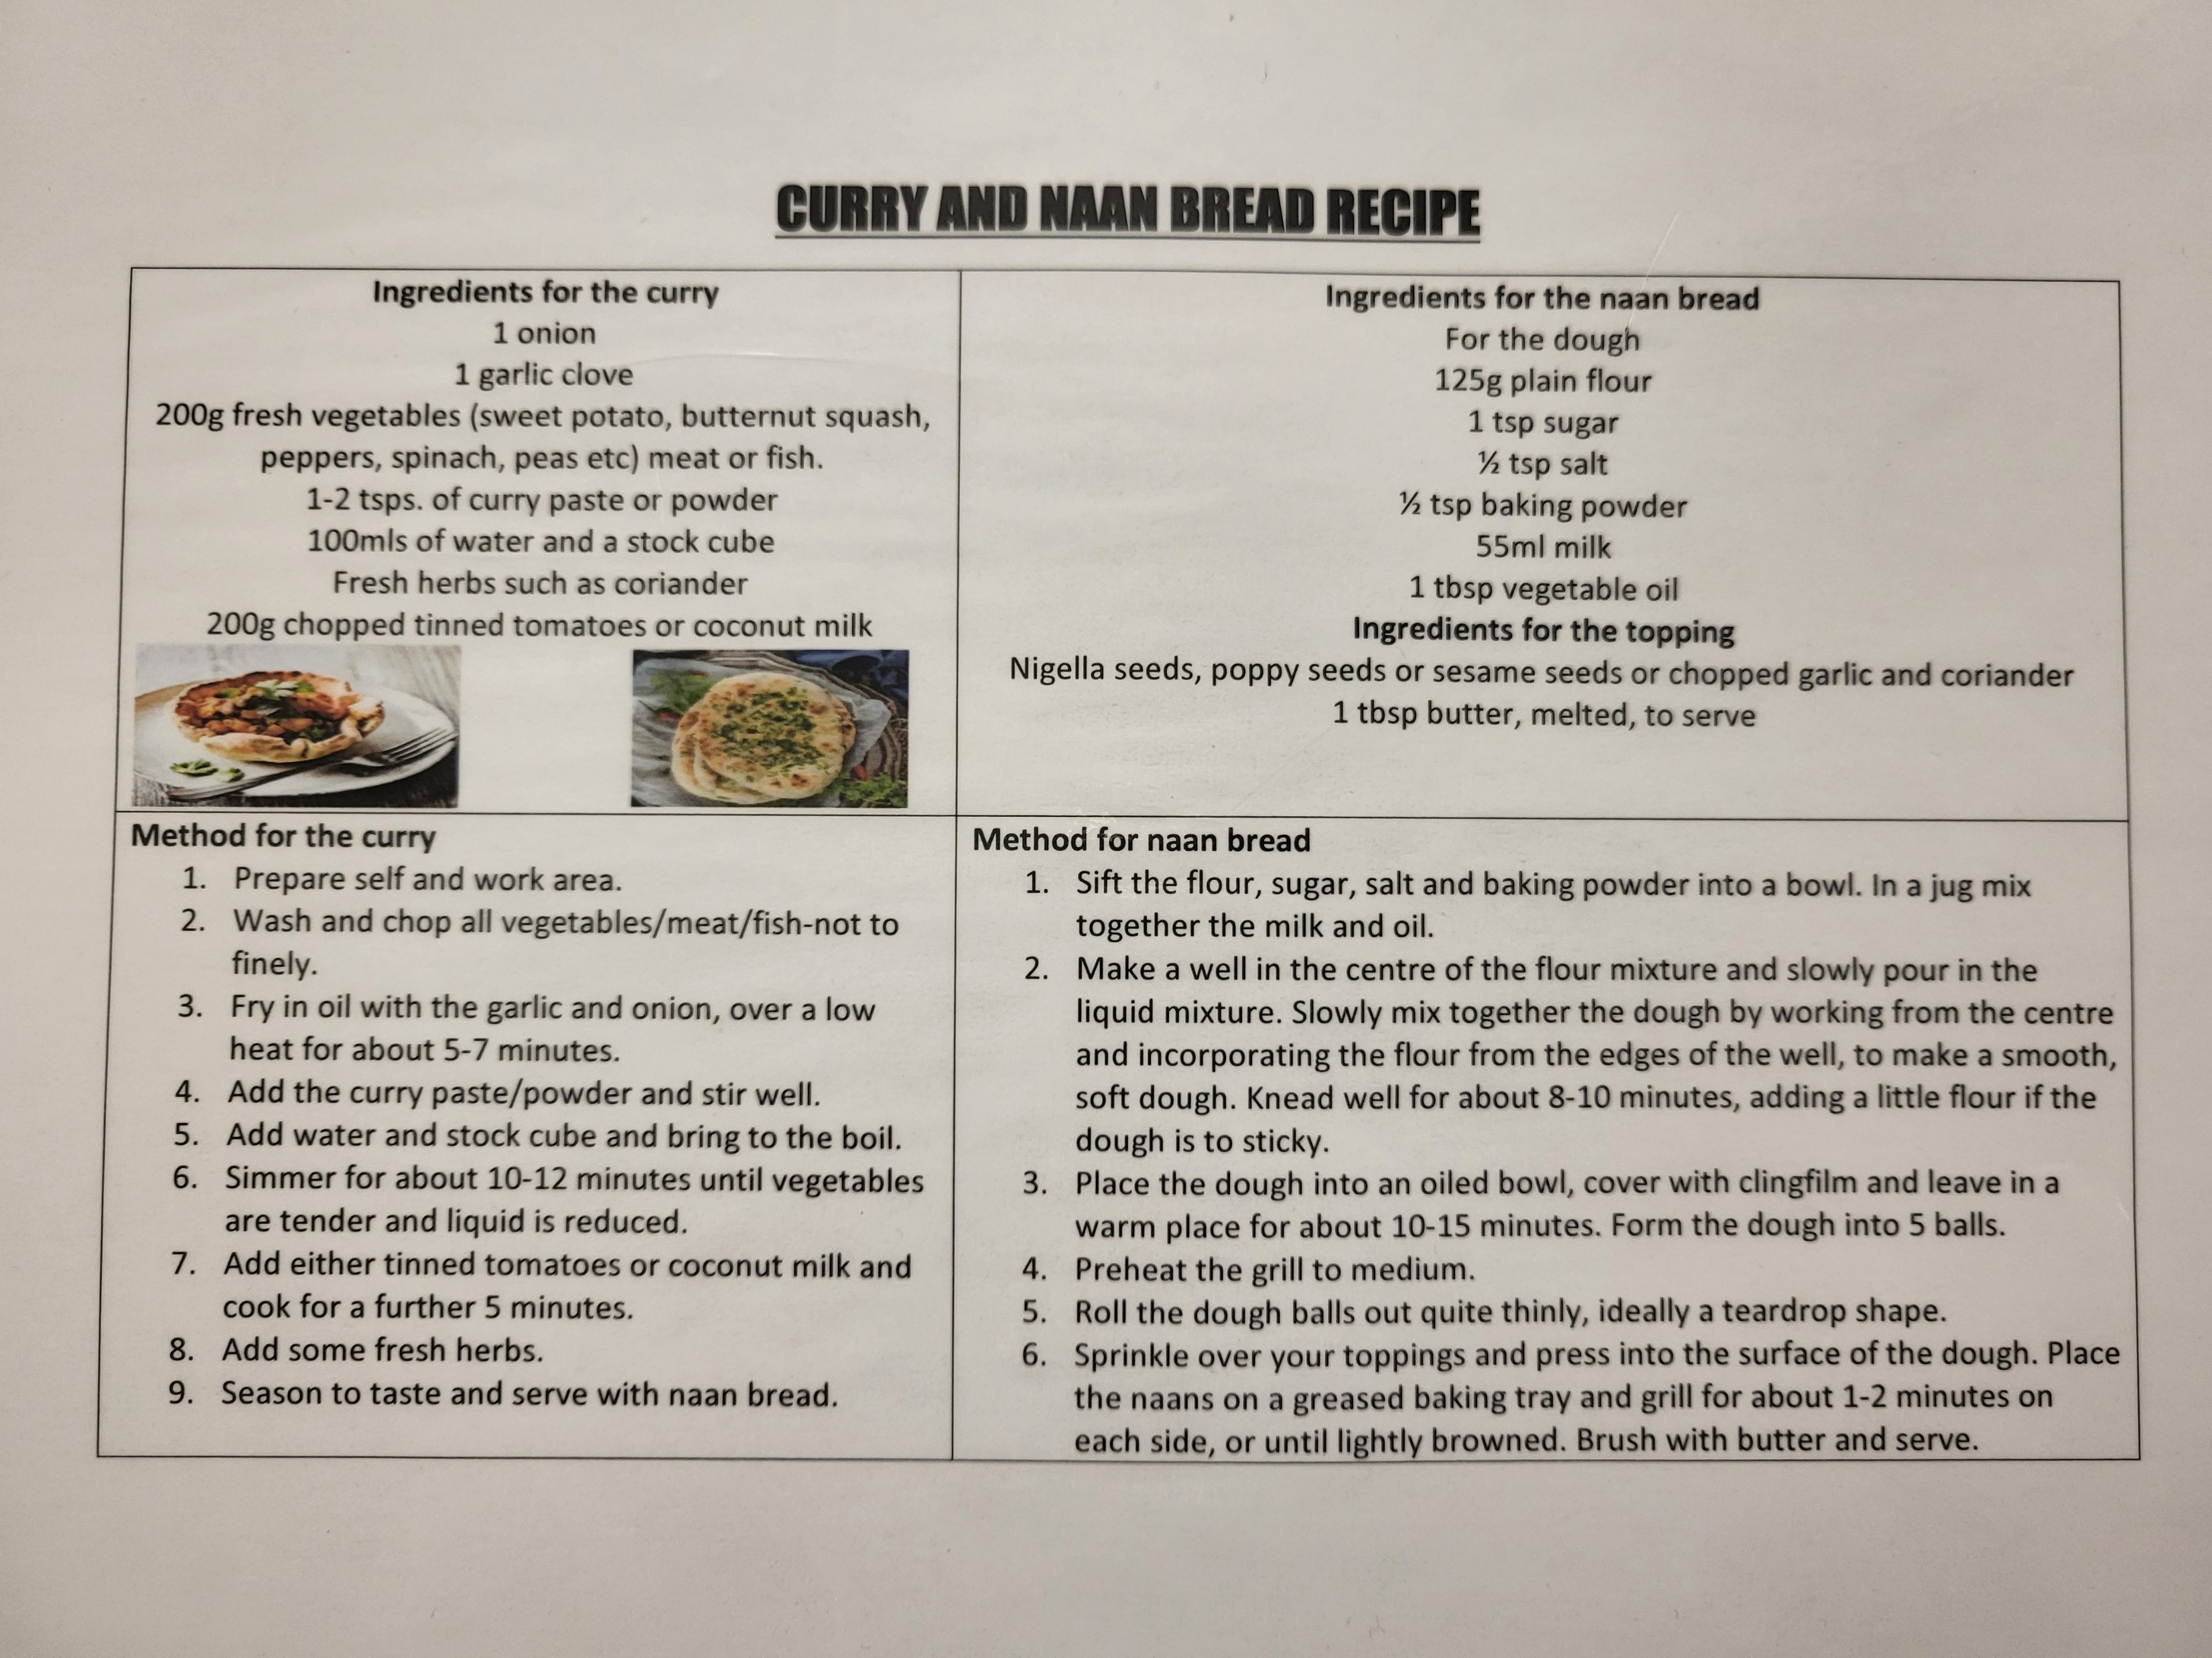

Slide 4
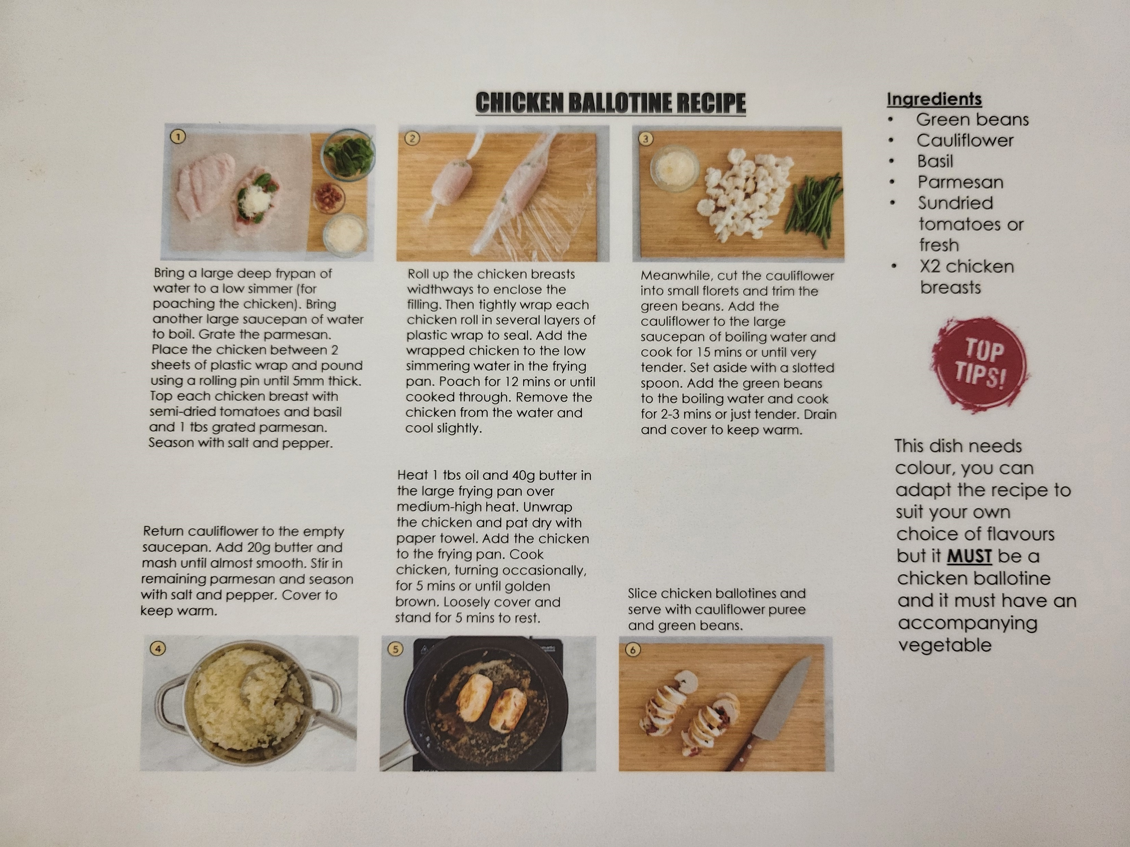

Slide 5
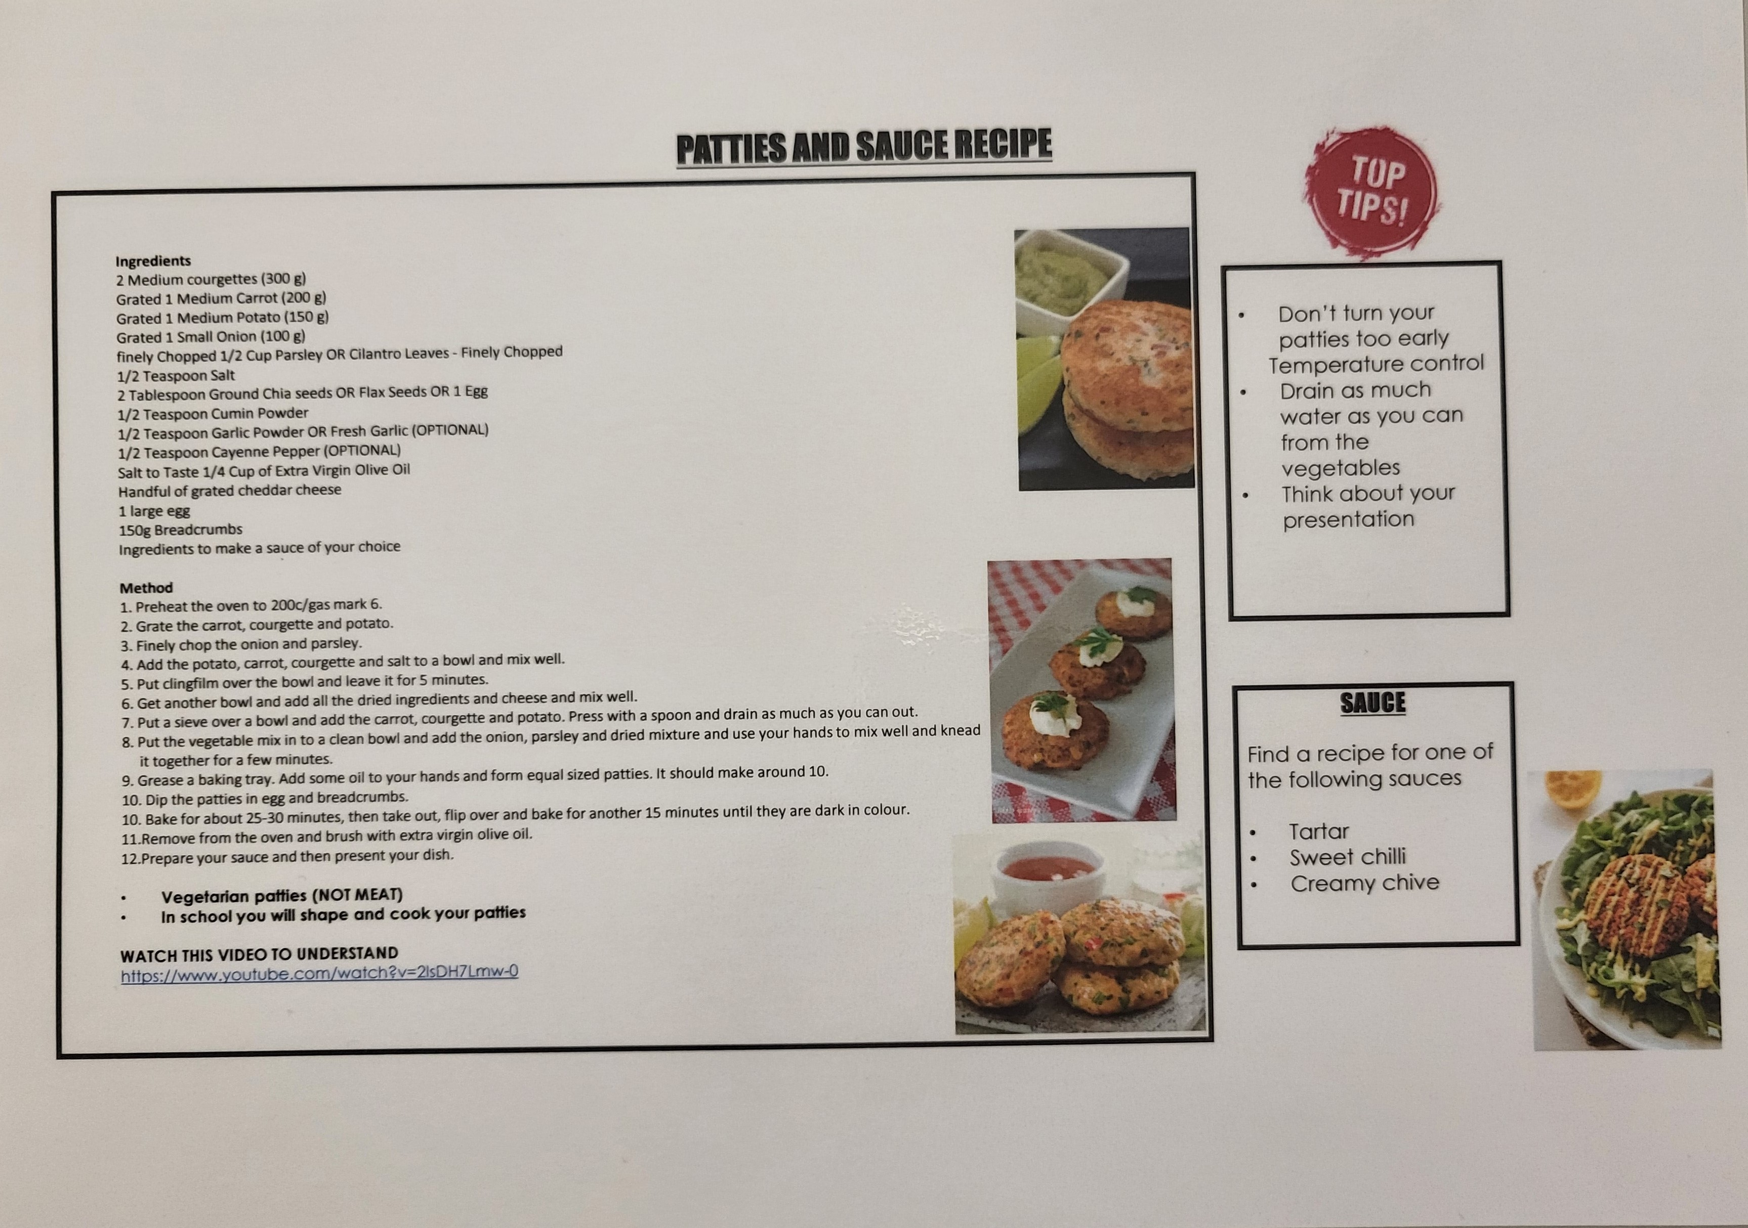

Slide 6
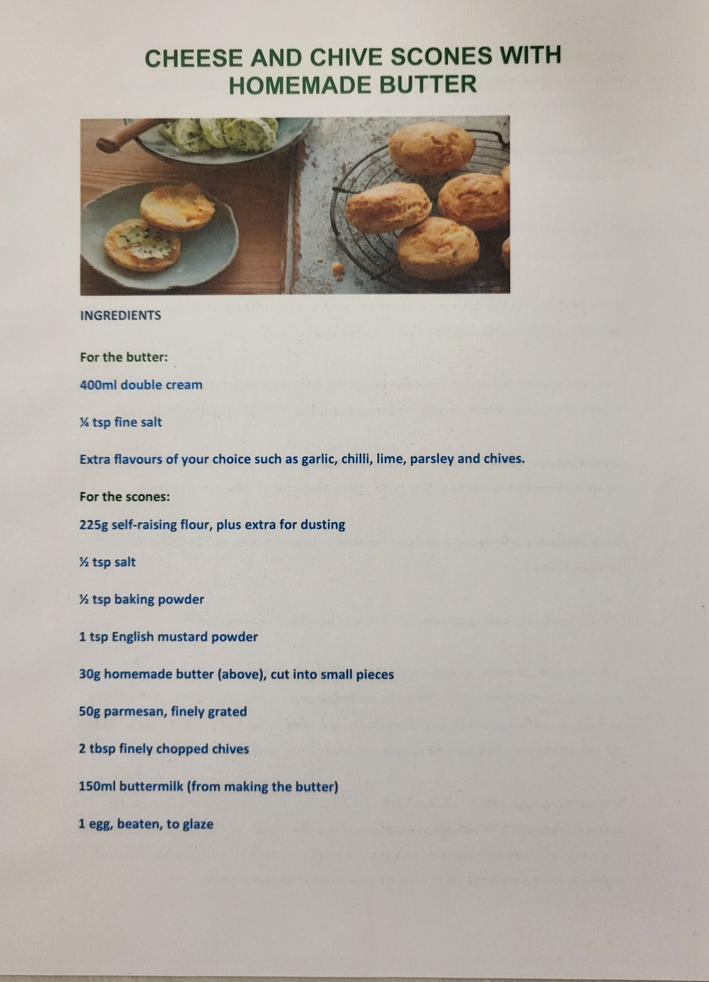
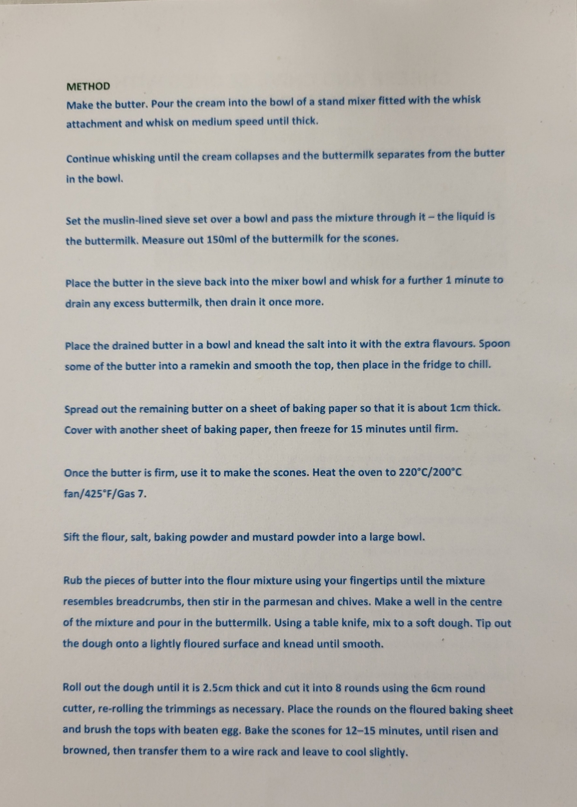

Slide 7
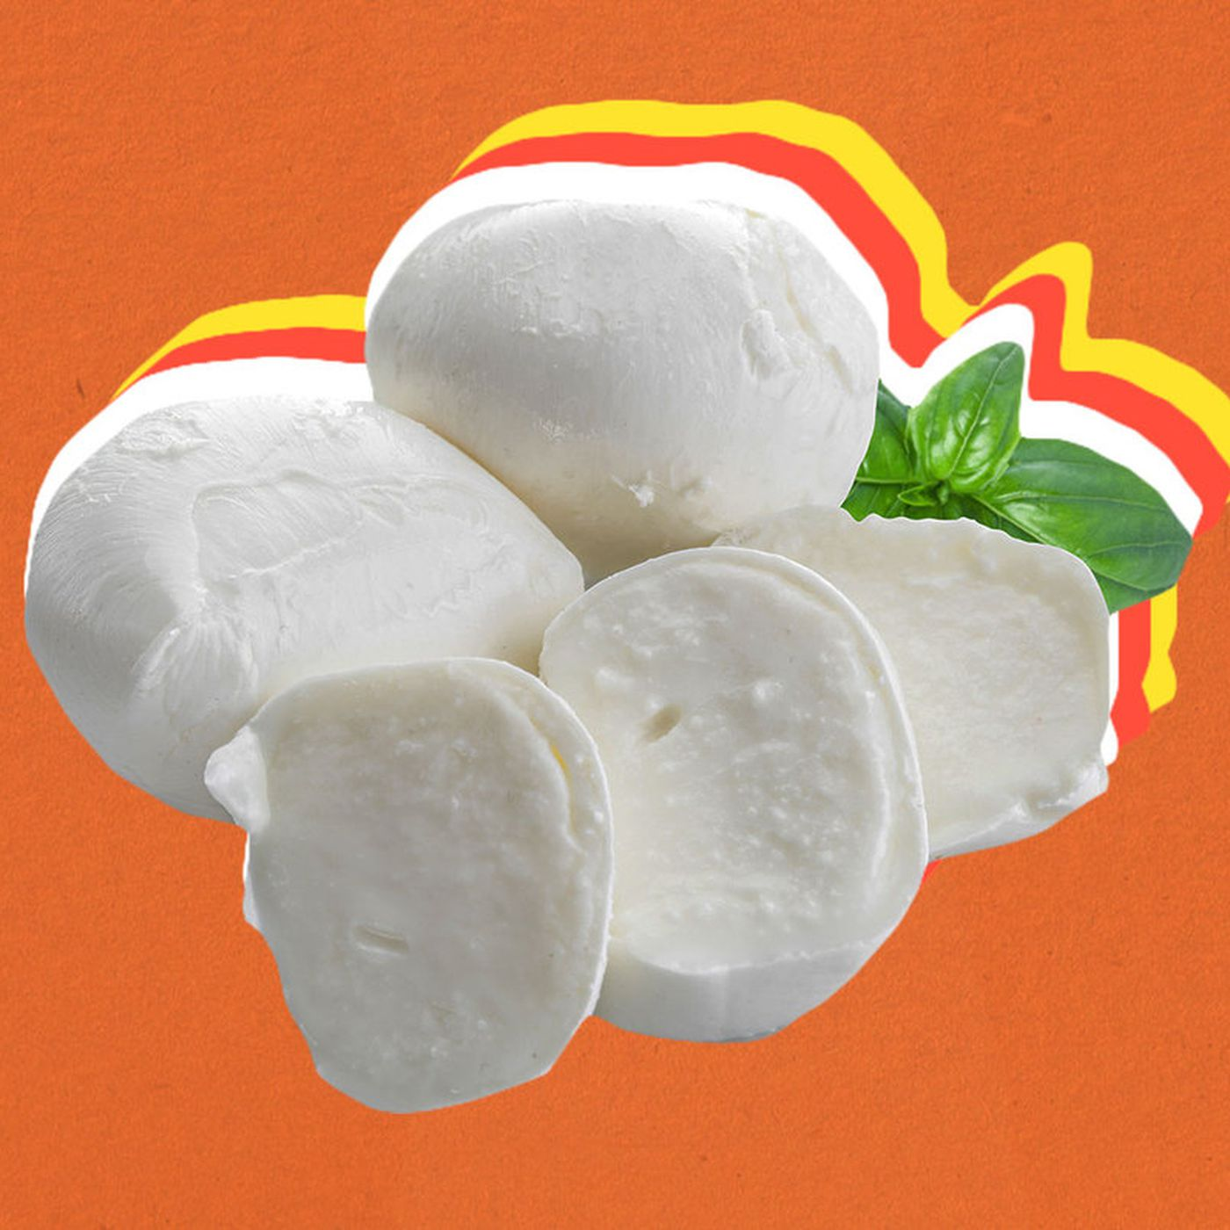
MOZZARELLA
INGREDIENTS
Ingredients
2.5g citric acid
60ml warm water
1litre unhomogenised milk
1.25g rennet
15g salt
Equipment
Measuring spoons, measuring jug, 1 x small mixing bowl, large saucepan, mixing spoon, temperature probe, slotted spoon, large bowl, sieve, thick rubber gloves.
METHOD
Dissolve 2.5g citric acid in 60ml warm water.
Pour milk into saucepan, heat gently to about 13°C.
Add the dissolved citric acid to the warm milk increasing heat to 30°C, stirring gently - it will start to curdle. Remove from the heat.
Add 1.25g rennet to the milk. Stir for 30 seconds - no more.
Leave the milk to stand off the heat for 5-10 minutes. The curds will separate from the whey.
Carefully scoop the curds from the pan using a slotted spoon and place them in a sieve over a bowl. Leave the whey in the pan.
Add salt to the whey and heat to 80C.
Put the gloves on. Divide the curds into three balls then dip one ball into the hot whey on a slotted spoon until it is warmed through, then gently stretch the ball or fold it back on itself. Keep doing this until it becomes stretchy and glossy. Don’t overwork it.
Mould and reshape the cheese into a ball.
Repeat for the remaining mozzarella.
Store in a bowl of chilled whey, refrigerate and use within 2 days.
https://www.foodafactoflife.org.uk/professional-development/teaching-and-learning/teacher-knowledge-and-skills/food-science-and-cooking/

